Slide 1
Tornadoes
Significant Events
The F-Scale
Scales of Rotation
Tornado Damage Patterns
Tornado Climatology
Tornado Measurements
Lab Experiments
Tornadogenesis
Supercell tornadoes
Non supercell tornadoes

Slide 2
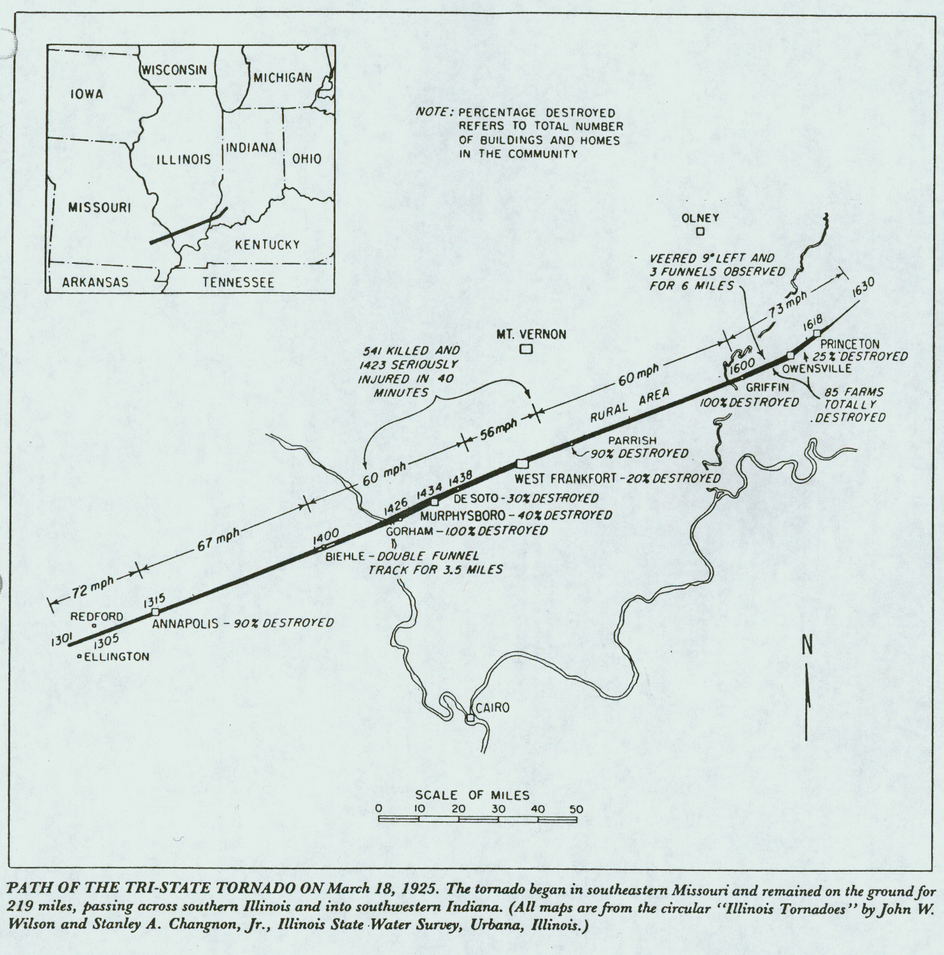
Significant Events: The Tri-State Tornado

Slide 3
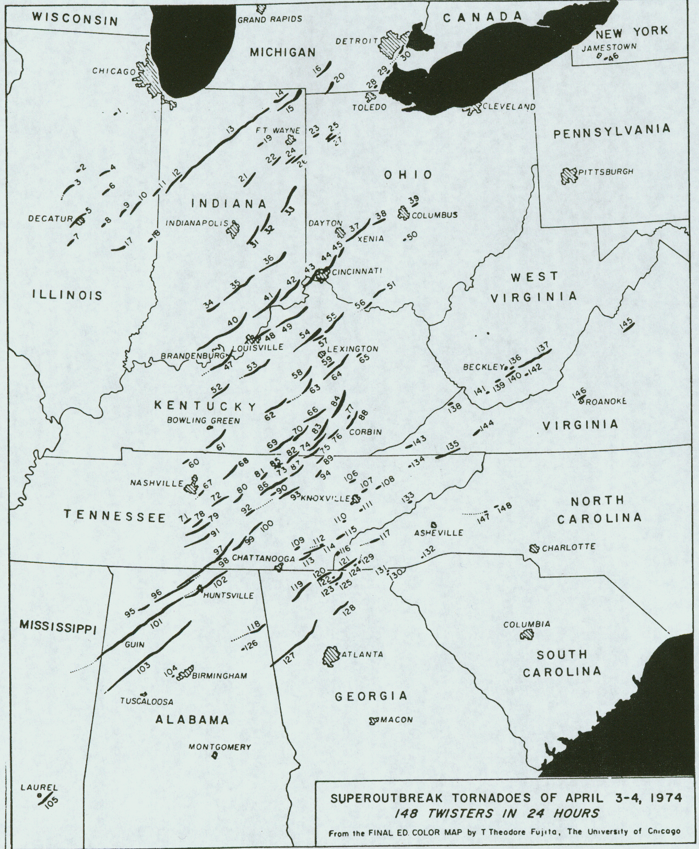
Significant Events: The super outbreak 3-4 April, 1974

Slide 4
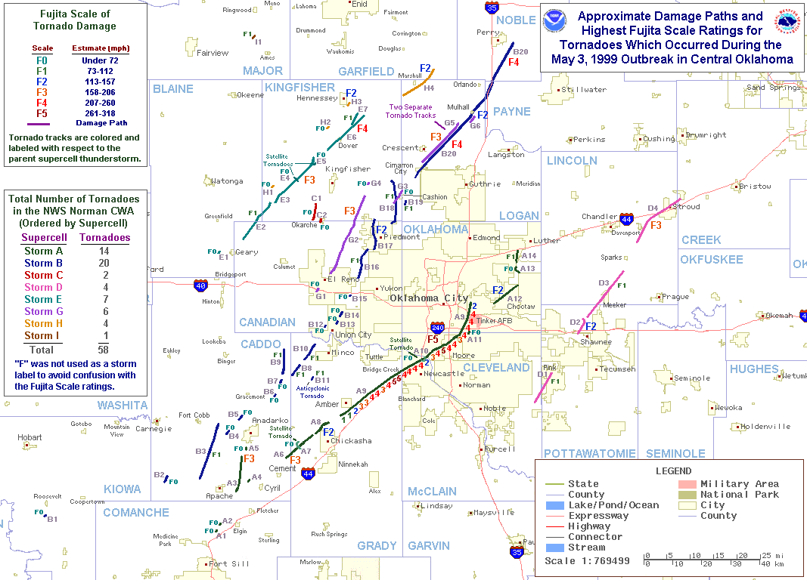
3 May 1999 (and many others since)

Slide 5
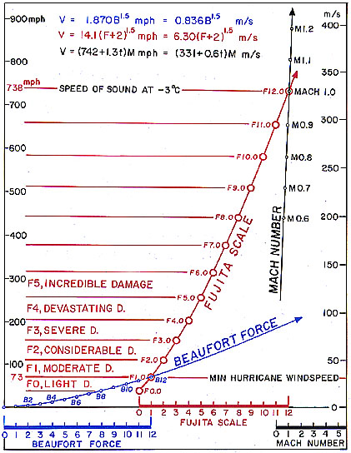
The F-Scale
As originally devised by Fujita, it connects the Beaufort and Mach scales.
Note that there are more than 6 F-scale categories

Slide 6
The F-Scale
Original Fujita Scale circa 1971
Fujita-Scale | Mean Wind Speed Range* (mph) | Qualitative damage description
F0 | 40 to 72 (45 – 78) | Light damage – some damage to chimneys and TV antennae; breaks twigs off trees; pushes over shallow rooted trees.
F1 | 73 to 112 (80–118) | Moderate damage – peels surface off roots; windows broken; light trailer houses pushed or overturned; some trees uprooted or snapped; moving automobiles pushed off the road. 73 mph is the beginning of hurricane wind speed.
F2 | 113 to 157 (119–161) | Considerable damage – roofs torn off frame houses leaving strong upright walls; weak buildings in rural areas demolished; trailer houses destroyed; large trees snapped or uprooted; railroad boxcars pushed over; light object missiles generated; cars blown off highway.
F3 | 158 to 206 (162-209) | Severe damage – roofs and some walls torn off frame houses; some rural buildings completely demolished; trains overturned; steel-framed hangar-warehouse type structures torn; cars lifted off the ground; most trees in a forest uprooted, snapped or leveled.
F4 | 207 to 260 (210-261) | Devastating damage – whole frame houses leveled, leaving piles of debris; steel structures badly damaged; trees debarked by small flying debris; cars and trains thrown some distances or rolled considerable distances; large missiles generated.
F5 | 261 to 318 (262-317) | Incredible damage – whole frame houses tossed off foundations; steel-reinforced concrete structures badly damaged; automobile-sized missiles generated; incredible phenomena can occur.
F6-F12 | 319 to sonic speed | Inconceivable damage – should a tornado with the maximum wind speed in excess of F6 occur, the extent and types of damage may not be conceived. A number of missiles such as ice boxes, water heaters, storage tanks, automobiles etc will create serious secondary damage on structures.
* - Wind speeds cited here are fastest one-quarter mile winds and the speeds in parentheses are 3-sec gust wind speeds.

Slide 7
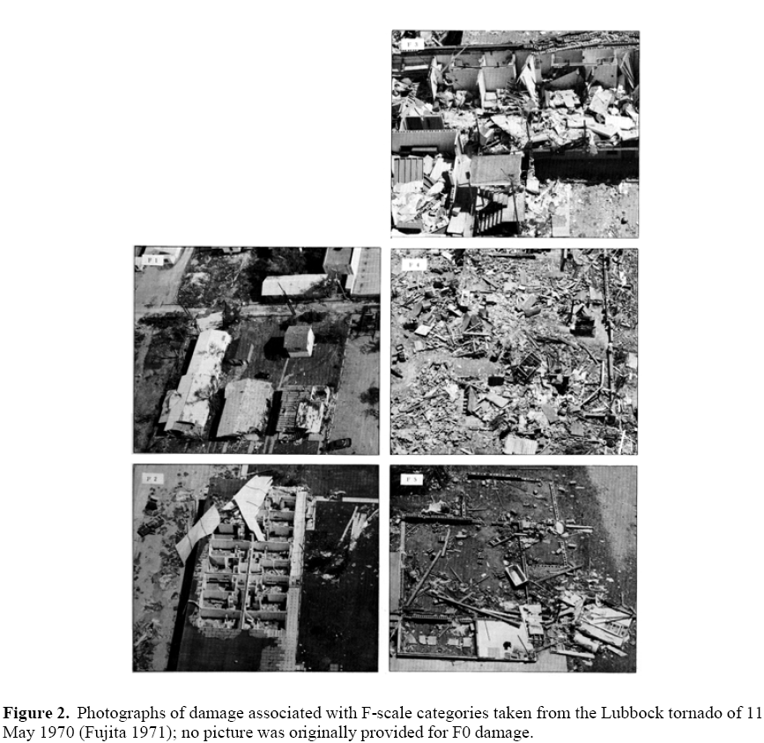
The EF-Scale
Examples of damage according to the F-Scale:

Slide 8
The EF-Scale
FUJITA SCALE |  |  | DERIVED EF SCALE |  | OPERATIONAL EF SCALE
F Number | Fastest 1/4-mile (mph) | 3 Second Gust (mph) | EF Number | 3 Second Gust (mph) | EF Number | 3 Second Gust (mph)
0 | 40-72 | 45-78 | 0 | 65-85 | 0 | 65-85
1 | 73-112 | 79-117 | 1 | 86-109 | 1 | 86-110
2 | 113-157 | 118-161 | 2 | 110-137 | 2 | 111-135
3 | 158-207 | 162-209 | 3 | 138-167 | 3 | 136-165
4 | 208-260 | 210-261 | 4 | 168-199 | 4 | 166-200
5 | 261-318 | 262-317 | 5 | 200-234 | 5 | Over 200
http://www.wdtb.noaa.gov/courses/EF-scale/index.html

Slide 9
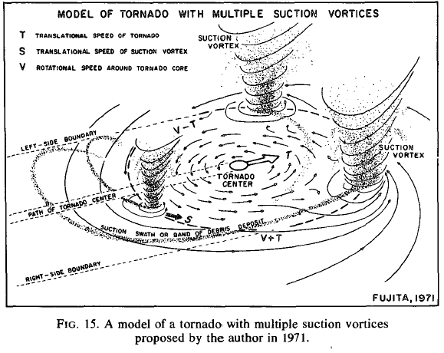
Scales of Rotation
Within a tornadic storm, especially supercells, there can be many scales of rotation present:
Mesocyclone – 2-7 km in scale – most often detectable by Doppler radar
Tornado - 100 – 1000 m in scale – very often not detectable by Doppler radar – will show up as a TVS – more on this later.
Suction vortices – 1 – 50 m in scale – only recently observed in high-resolution Doppler radar

Slide 10
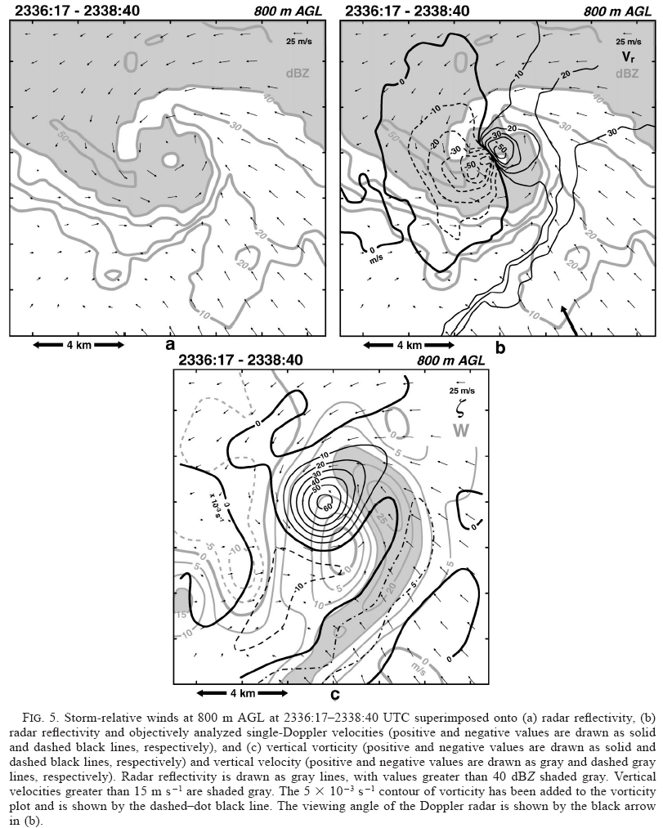
Mesocyclones
Mid level – 3-7 km AGL
Only 25-30% of supercells with mid-level mesocyclones produce tornadoes
Low-level – 1-3 km AGL
Often associate with hook echo
And wall cloud
From Wakimoto et al. 2003 - MWR

Slide 11
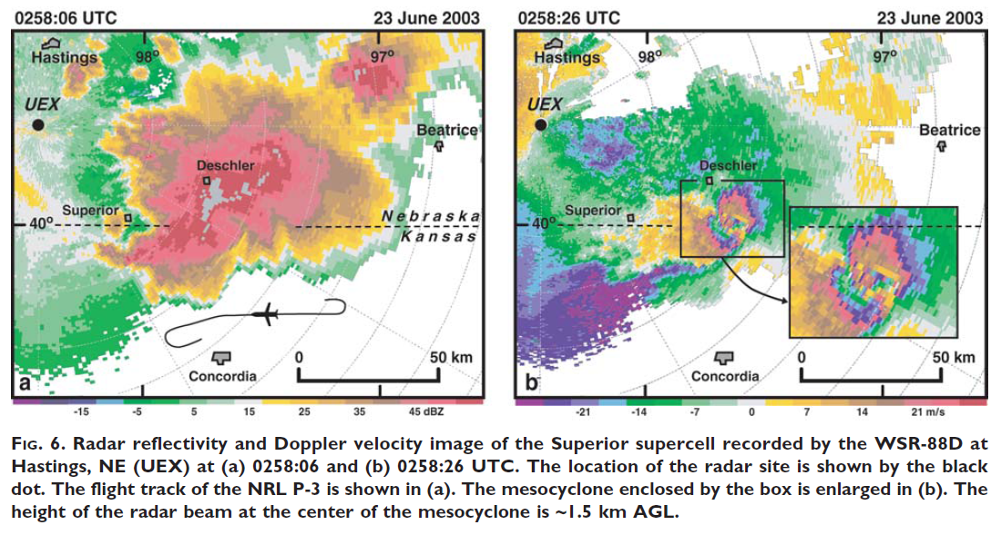
The largest ever documented mesocyclone (from Wakimoto et al. 2004 – BAMS)

Slide 12
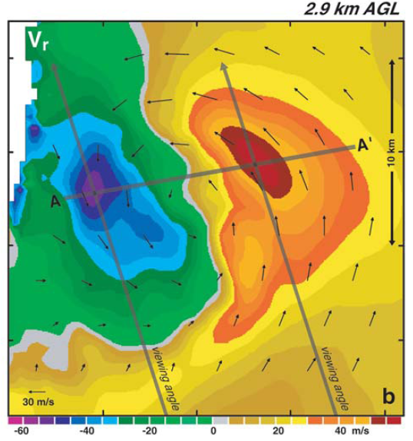
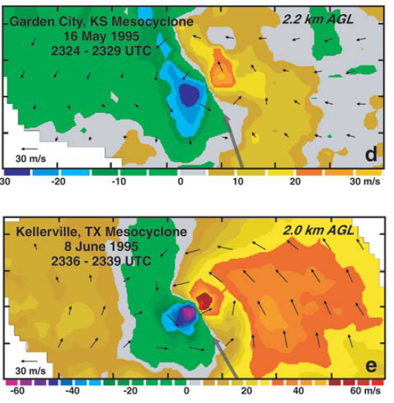
The largest ever documented mesocyclone (from Wakimoto et al. 2004 – BAMS)
Non tornadic Hastings, NE mesocyclone
Tornadic mesocyclones

Slide 13
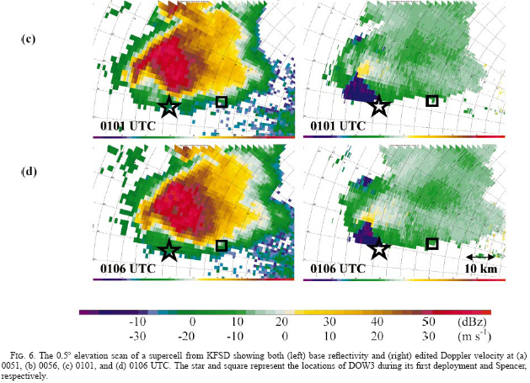
Mesocyclones
WSR-88D observations:
Notice that the spatial resolution is not that great
From Alexander and Wurman, 2005 - MWR

Slide 14
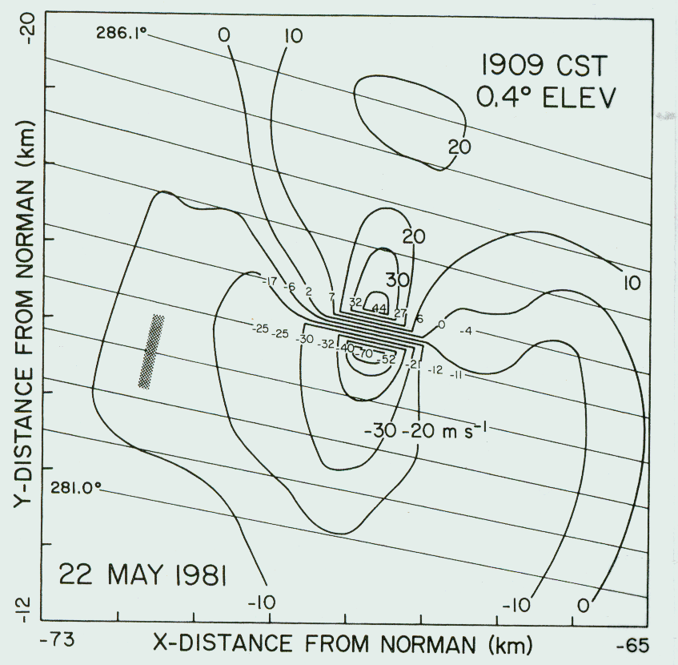
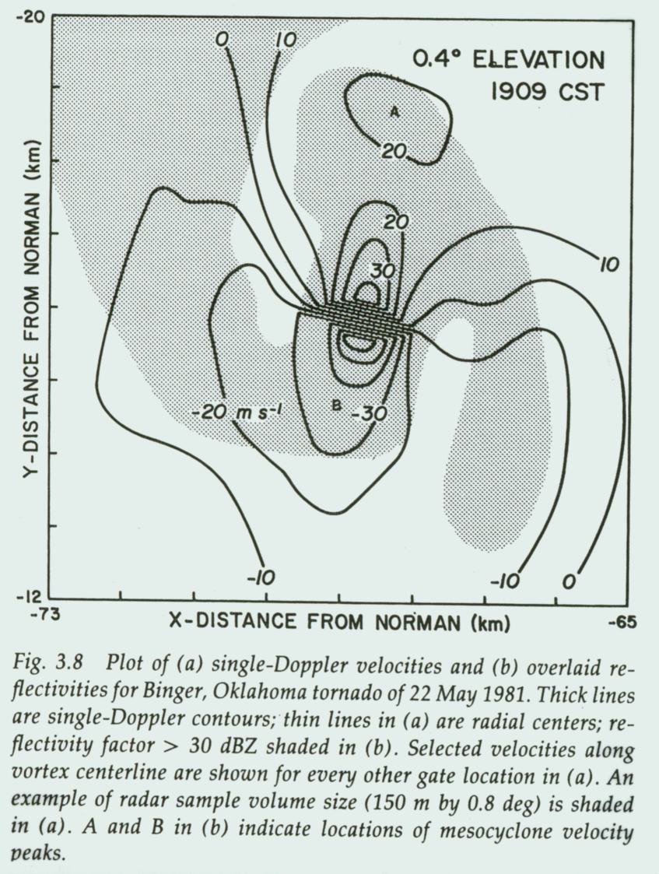
Tornadoes and the Tornado Vortex Signature (TVS)
Historically, a tornadic circulation has shown up as a region of enhanced gate-to-gate (adjacent beams) azimuthal shear:
Mesocyclone tornado
From Burgess et al. 1990 – Radar in Met.

Slide 15
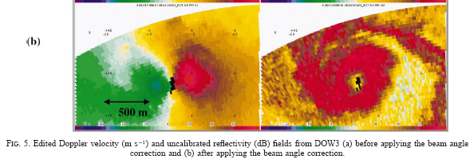
Radar Observations of Tornadoes
Have only recently been made with the requisite resolution to resolve the tornadic circulation:
Here is one example:
From Alexander and Wurman 2005 - MWR

Slide 16
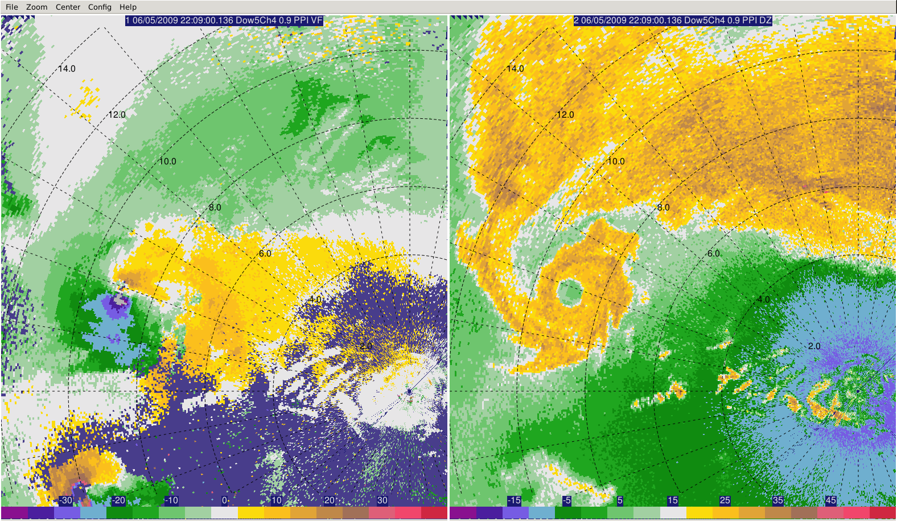
Radar Observations of Tornadoes
Another example: DOW 5 observations of the 05 June 2009 Goshen Co. tornado

Slide 17
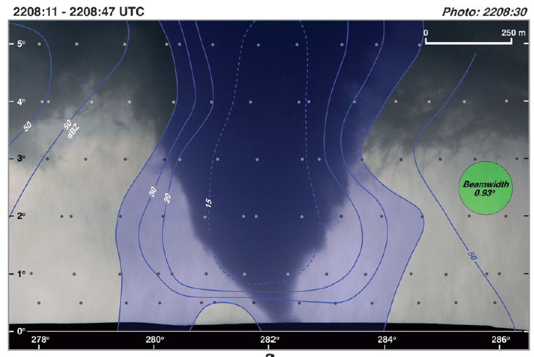
Radar Observations of Tornadoes – relationship to visual characteristics
From Wakimoto et al. 2011 - MWR

Slide 18
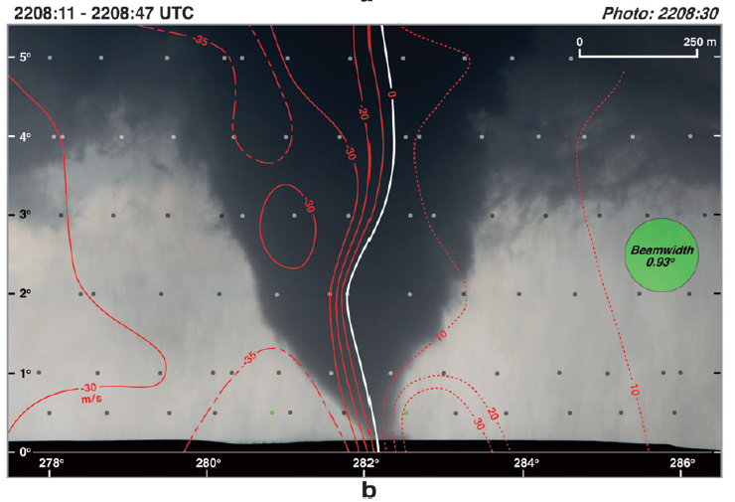
Radar Observations of Tornadoes – relationship to visual characteristics
From Wakimoto et al. 2011 - MWR

Slide 19
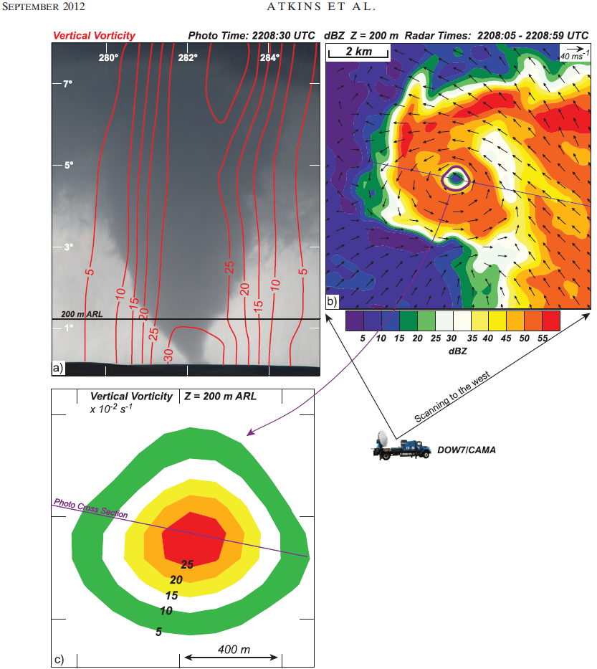
Radar Observations of Tornadoes – relationship to visual characteristics
From Atkins et al. 2012 - MWR

Slide 20
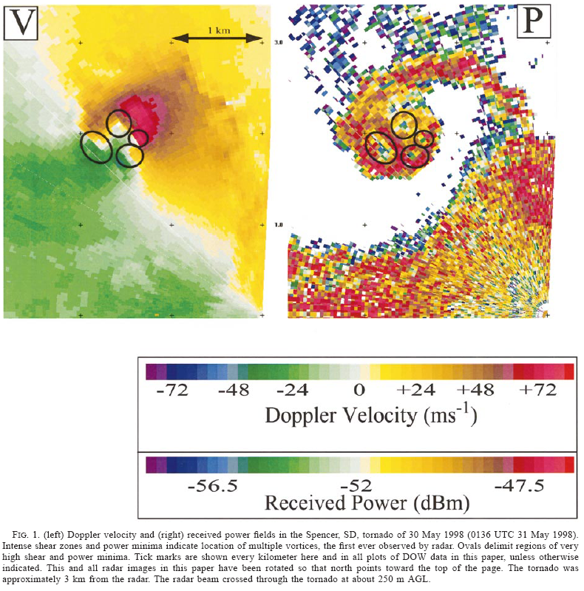
Radar Observations of (multiple) Suction Vortices?
Can we see embedded couplets within the overall tornadic circulation? Not until just recently with mobile Doppler radars:
From Wurman 2002 - WAF

Slide 21
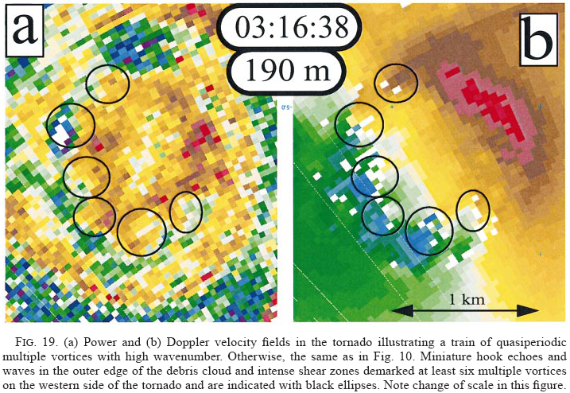
Radar Observations of Suction Vortices?
From Wurman 2002 - WAF

Slide 22
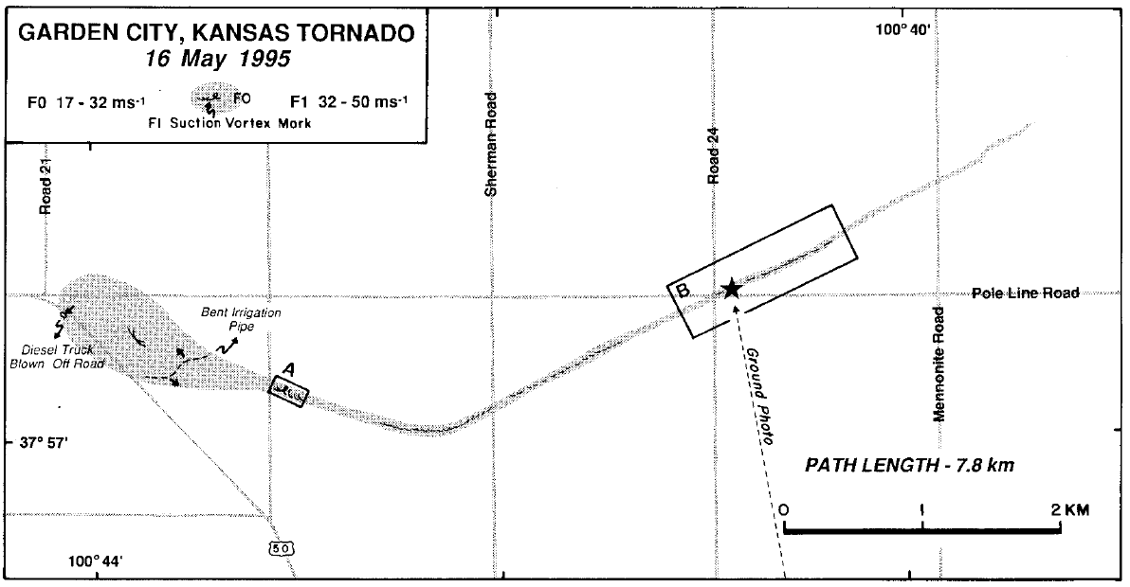
Tornado Damage Patterns
Wakimoto et al. (1998 – MWR)

Slide 23
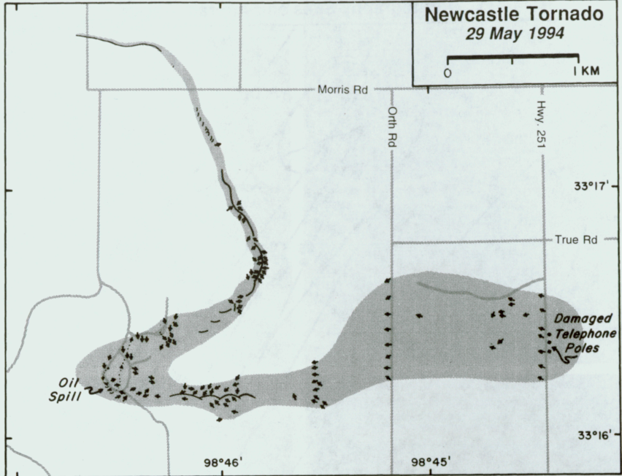
Tornado Damage Patterns
Wakimoto and Atkins (1996 – MWR)

Slide 24
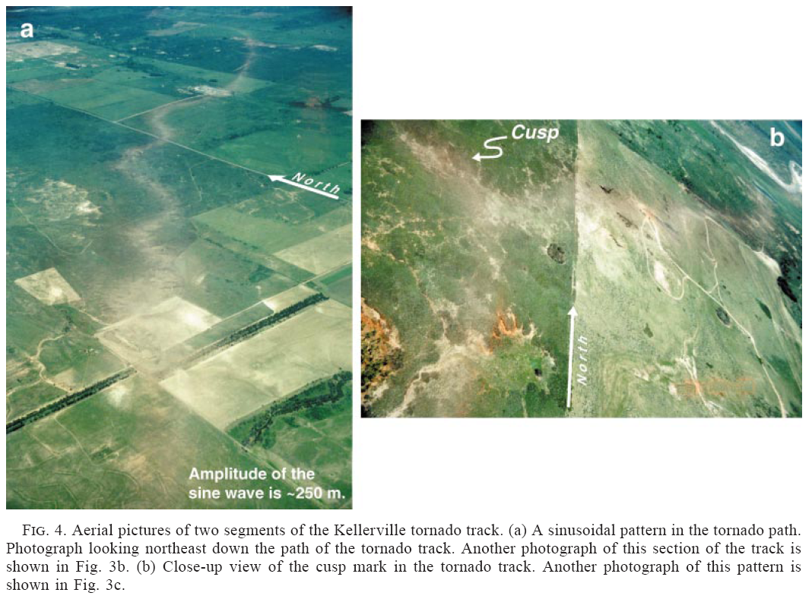
Tornado Damage Patterns
Wakimoto et al. (2003 – MWR)

Slide 25
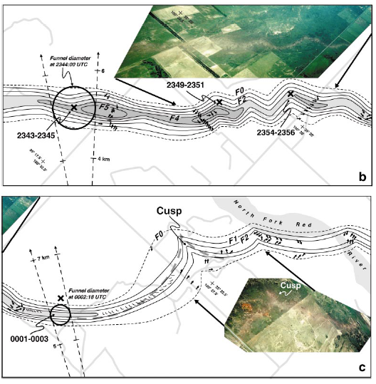
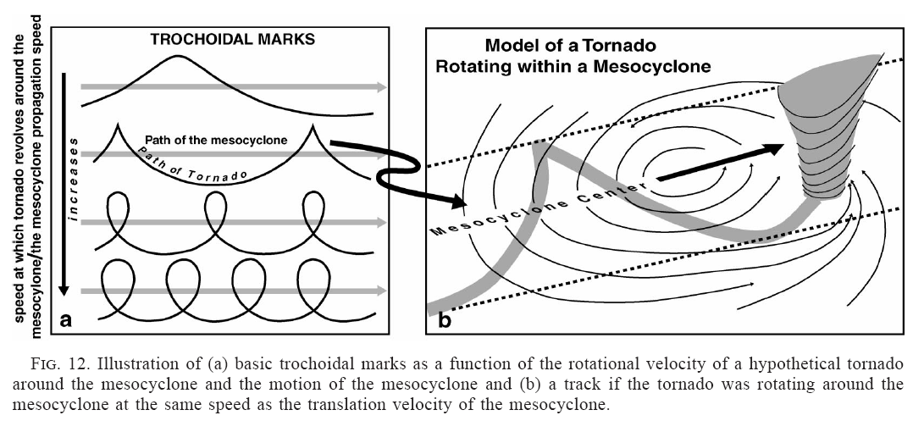
Wakimoto et al. (2003 – MWR)

Slide 26
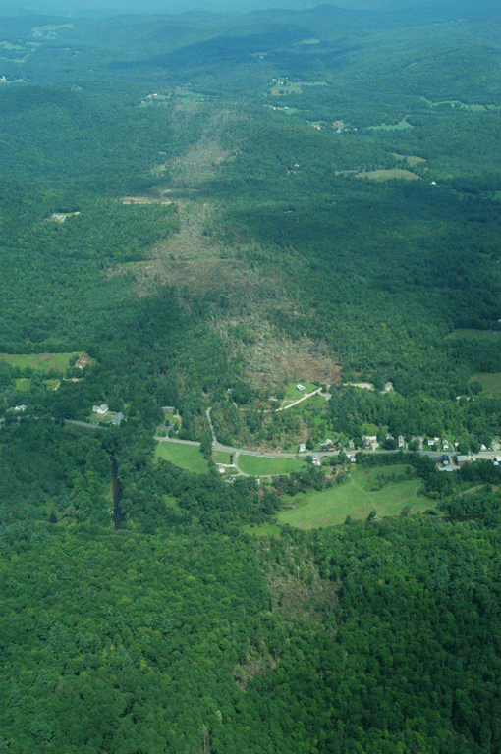
Tornado Damage Patterns 21 July 2003 near Cavendish, VT This tornado was produced by a bow echo! Survey by N. Atkins

Slide 27
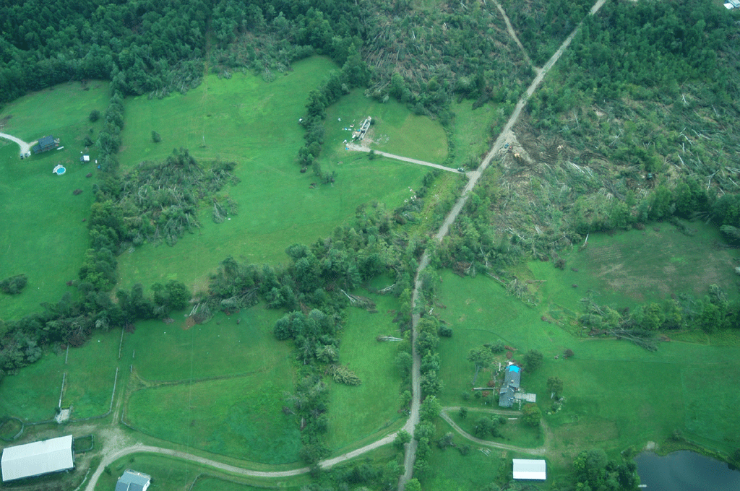
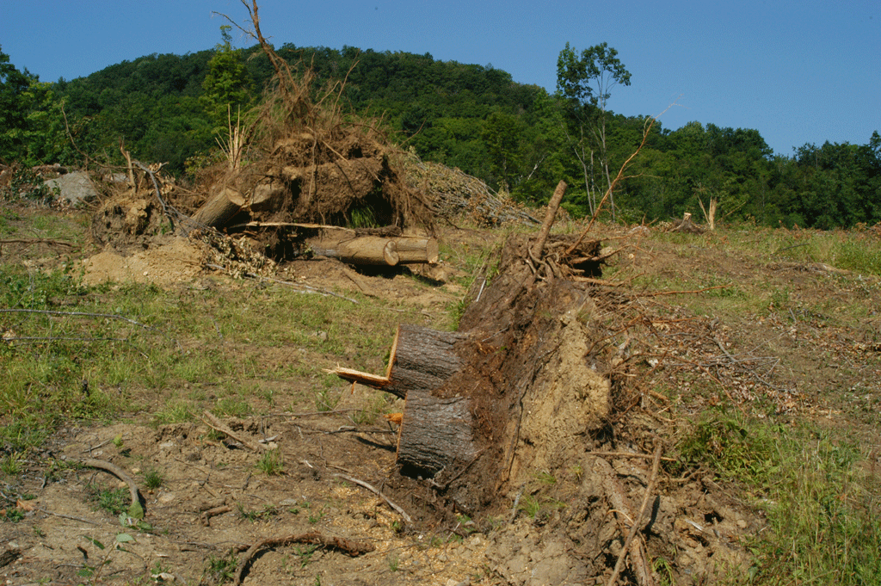
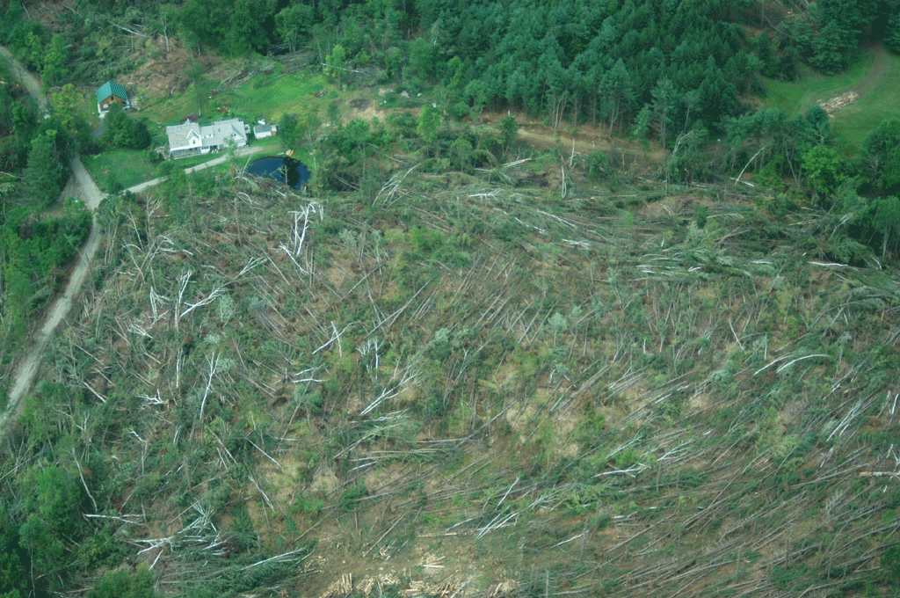
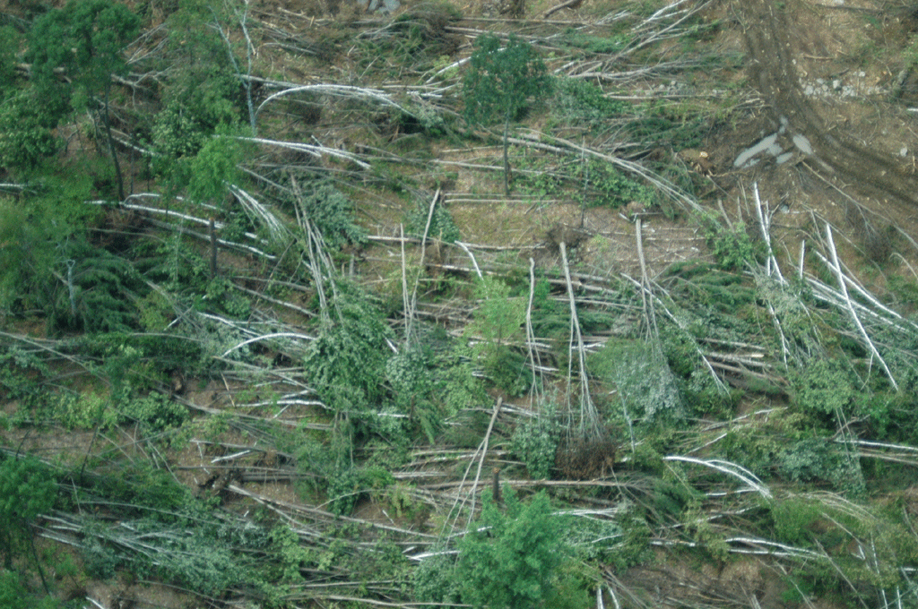
Tornado Damage Patterns

Slide 28
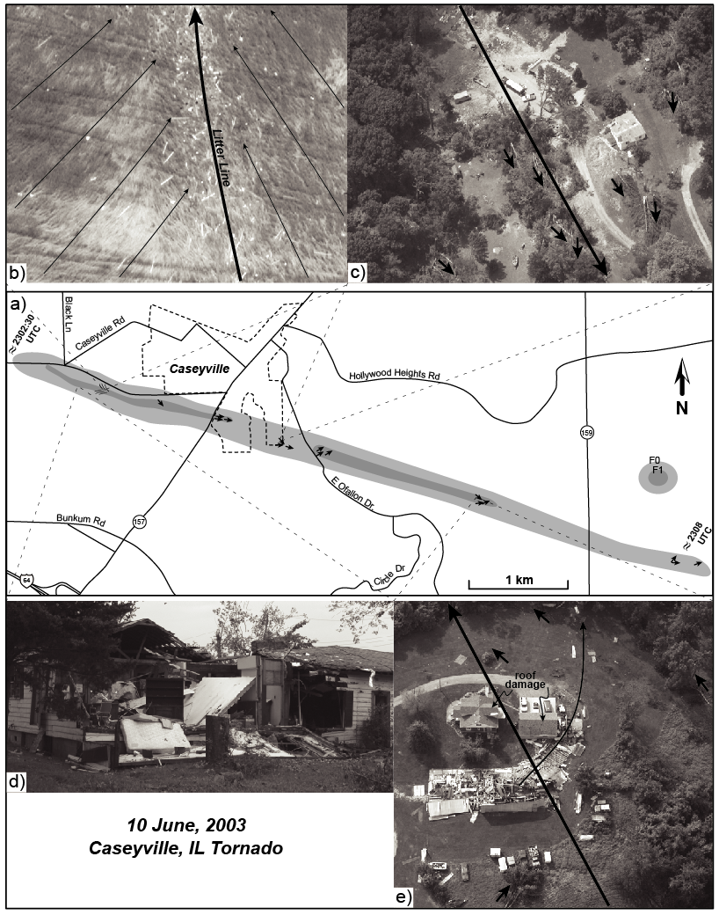
Tornado Damage Patterns
From Atkins et al. (2005- MWR

Slide 29
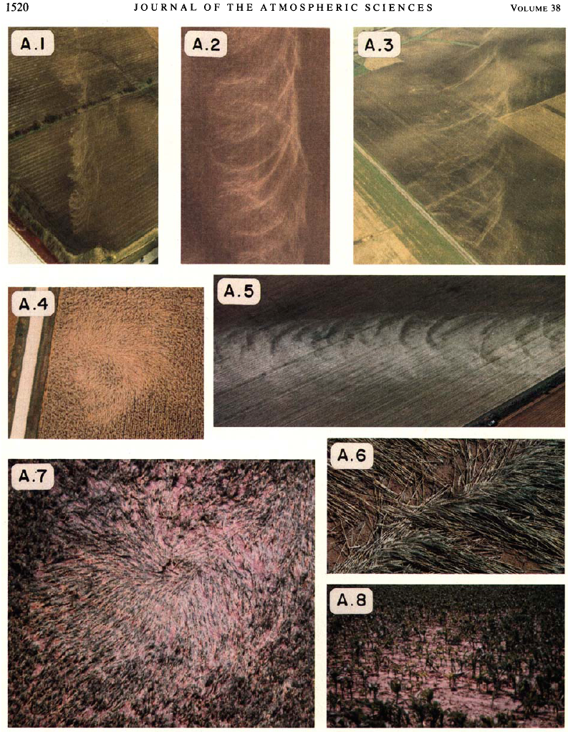
Tornado Damage Patterns Examples of suction vortex markings
From Fujita (1981-JAS)

Slide 30
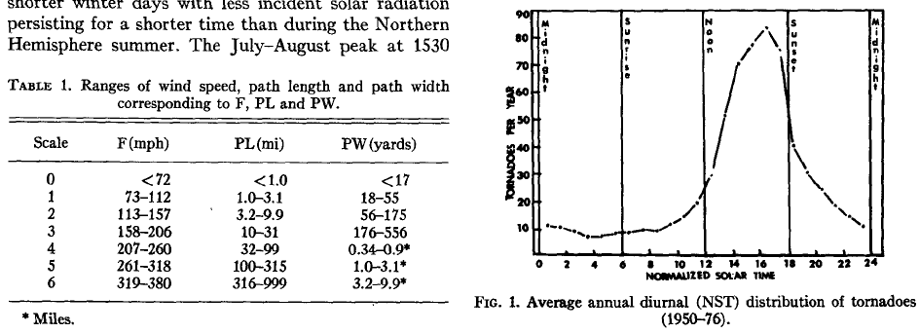
Tornado Climatology Contemporary data can be found at: http://www.ncdc.noaa.gov/oa/climate/severeweather/tornadoes.html
From Kelly et al. (1978-MWR)

Slide 31
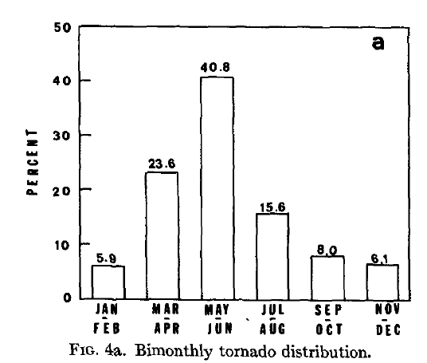
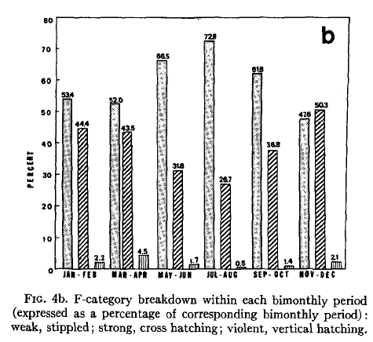
Tornado Climatology
From Kelly et al. (1978-MWR)

Slide 32
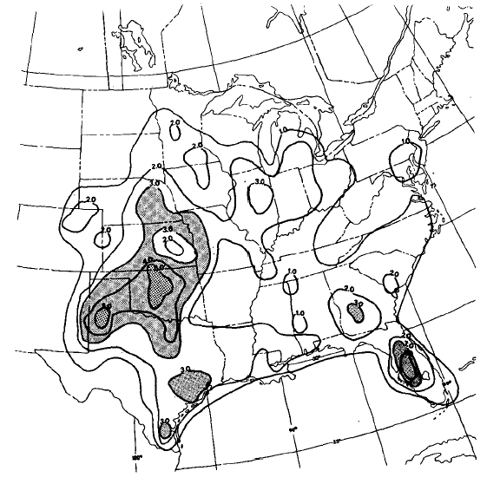
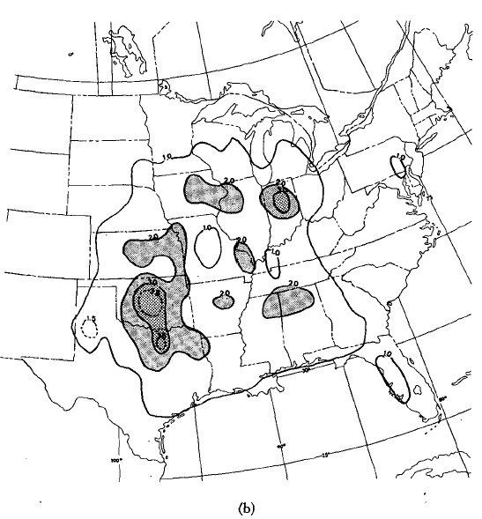
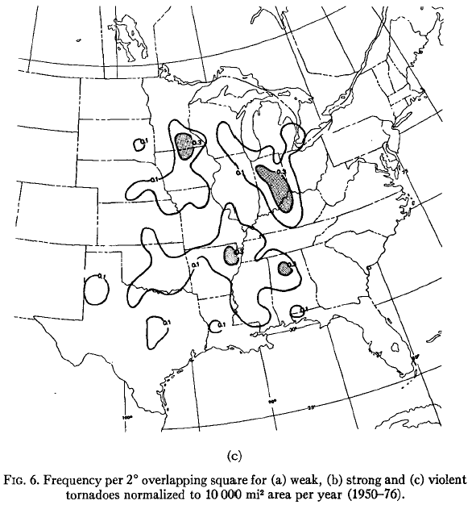
Do you see the location of “tornado alley”?
From Kelly et al. (1978-MWR)

Slide 33
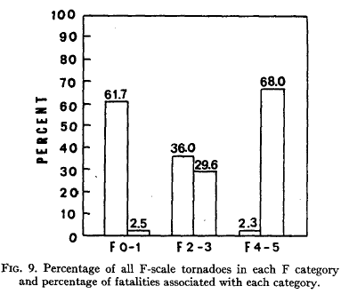
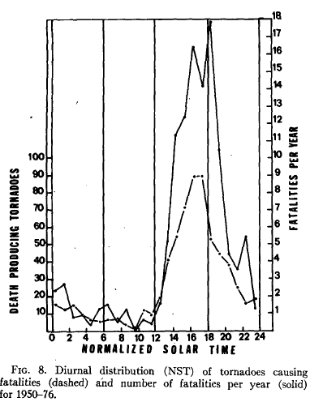
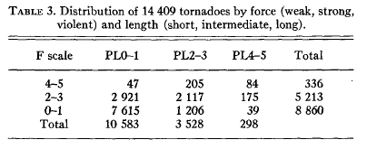
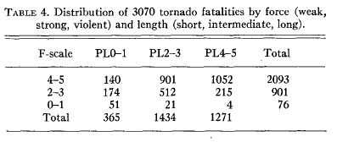
From Kelly et al. (1978-MWR)

Slide 34
From Kelly et al. (1978-MWR)

Slide 35
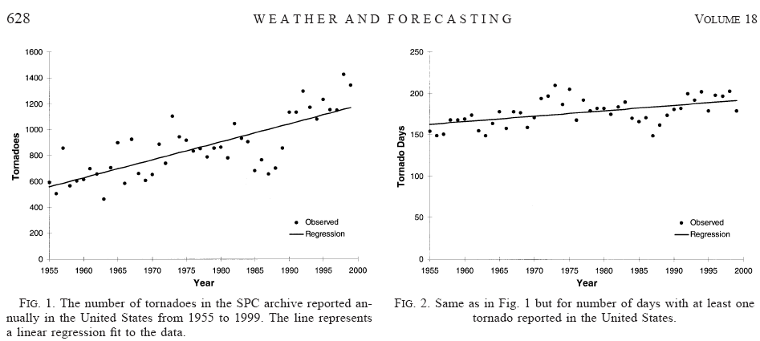
From Brooks et al. (2003) - WAF

Slide 36
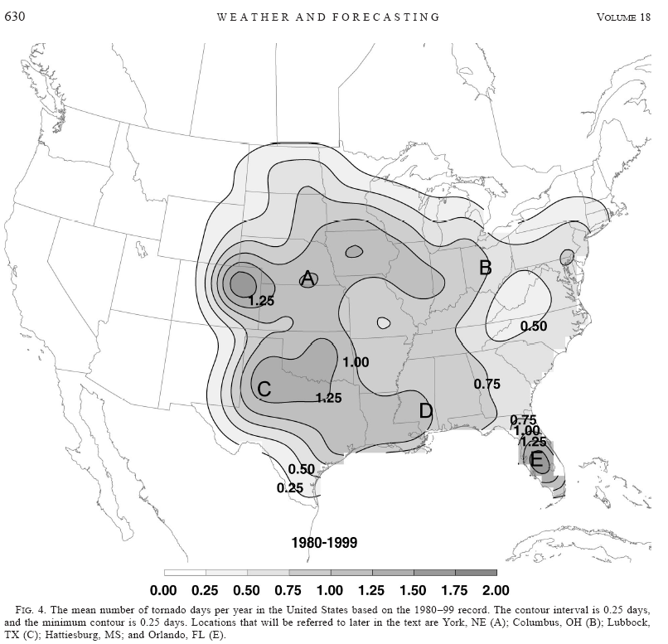
From Brooks et al. (2003) – WAF
Spatial climatology for any severe can be found on the SPC page:
http://www.spc.noaa.gov/new/SVRclimo/climo.php?parm=anySvr

Slide 37
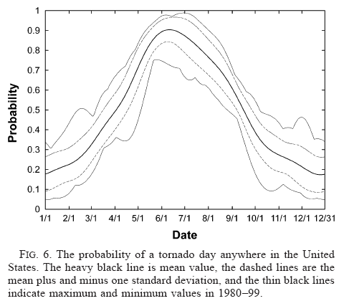
From Brooks et al. (2003) - WAF

Slide 38
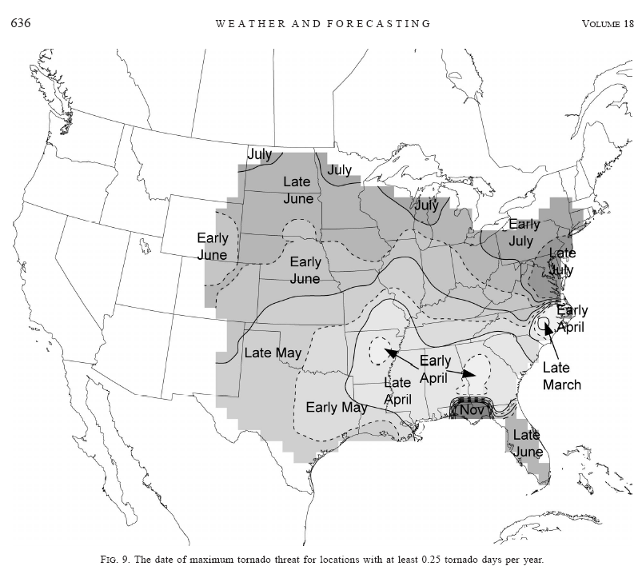
From Brooks et al. (2003) - WAF

Slide 39
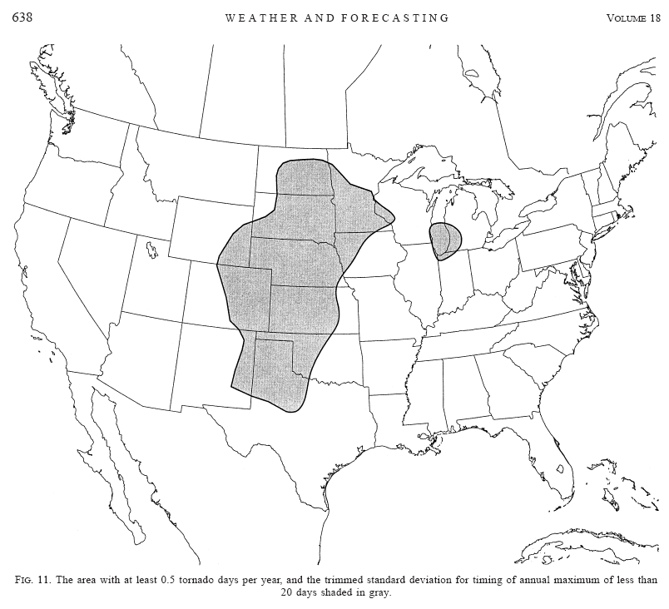
A new tornado alley
From Brooks et al. (2003) - WAF

Slide 40
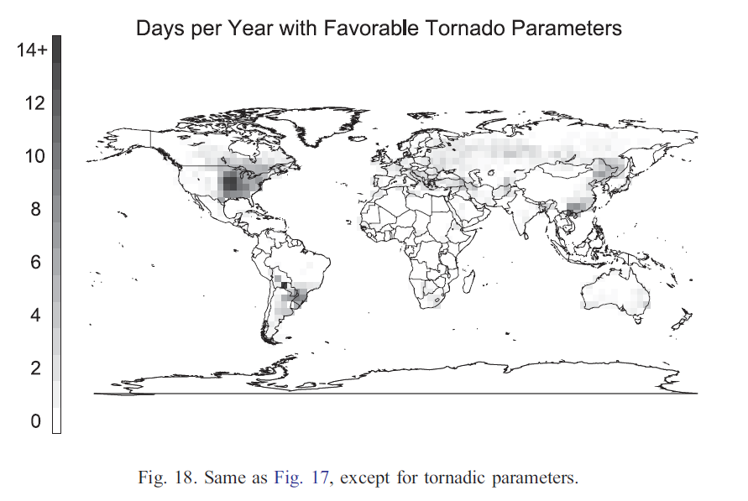
Brooks et al. 2003, Atm. Research

Slide 41
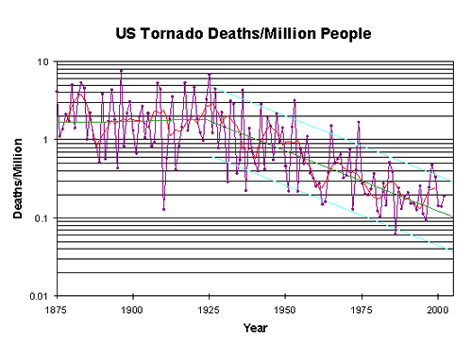
From Grazulis – 19th SLS

Slide 42
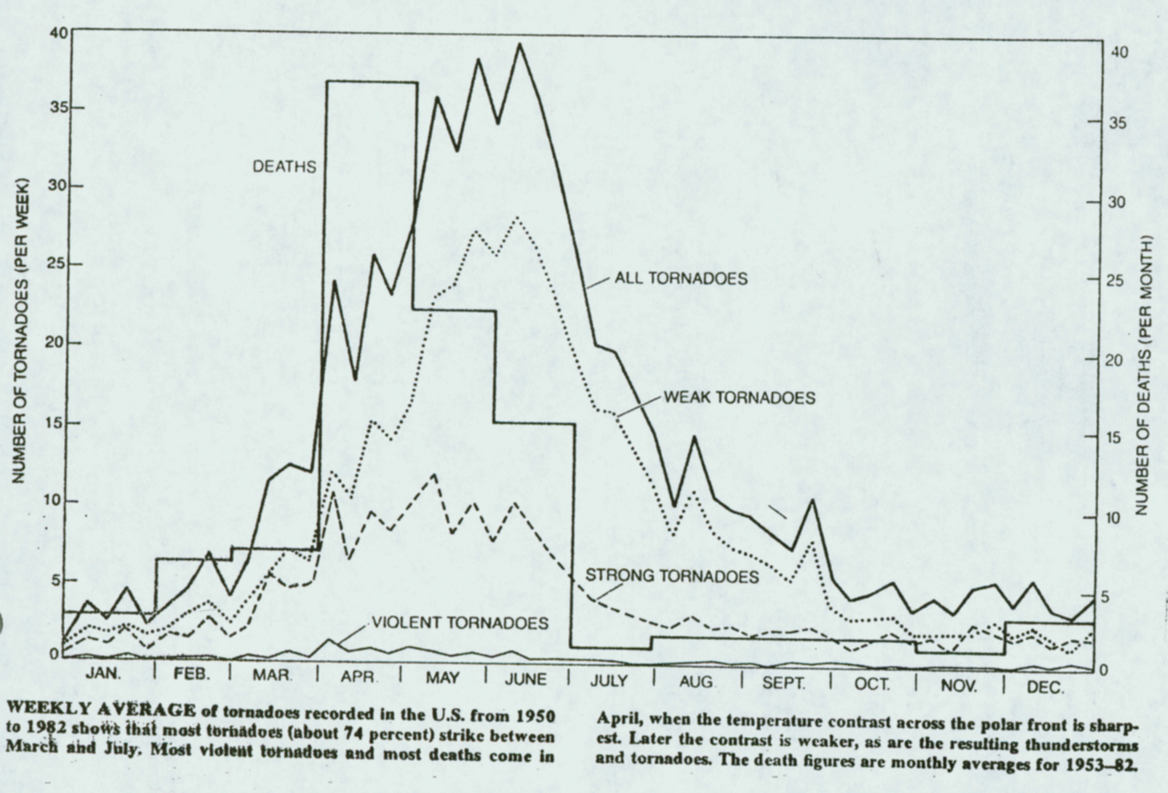
From Grazulis

Slide 43
From Grazulis

Slide 44
24th Severe Local Storms Conference

Slide 45
Tornado Measurements
From Bedard and Ramzy (1983 - JAM

Slide 46
Tornado Measurements
From Bedard and Ramzy (1983 - JAM

Slide 47
Tornado Measurements
From Bedard and Ramzy (1983 - JAM

Slide 48
Tornado Measurements
From Bluestein (1983 - JAM

Slide 49
CSWR Pods

Slide 50
Texas Tech
Sticknets

Slide 51
The Tornado Intercept Vehicle……….

Slide 53
Mobile Mesonet

Slide 54
Disdrometers (tells you how many and how big the precipitation particles are)

Slide 55
Remote Sensing
C-Band Radars – Storm Scale
X-band radars (some dual-Pol) – hook/mesocyclone scale

Slide 56
W-band – tornado scale

Slide 57
Rapid Scan and Phased Array Radars

Slide 58
Tornado Measurements
Rockets?
From Samaras (2004 – SLS Conf.)

Slide 59
Tornado Measurements
Hardened In-situ Tornado Pressure Recorder (HITPR)
Data from an F4 tornado
From Lee et al. (2004 – SLS Conf.)

Slide 60
Laboratory Experiments
Vortex Chambers:
There are two important parameters to consider with simulating a tornado with a vortex chamber:
The circulation of the flow about the central axis = Γ
The rate of air flow through the chamber, Q
The ratio Γ and Q is called the swirl ratio
Tornadoes form when the swirl ratio is large.

Slide 61
Laboratory Experiments
Vortex Chambers:
Notice that when the swirl ratio is small (a), a simple vortex is generated dominated by updraft
As the swirl ratio increases (b) and (c), notice that the simple vortex structure is lost.
In (c), notice that a downdraft is found aloft in the vortex
In (d), the downdraft extends to the ground and a two-celled vortex is created. It is thought that such an air flow is present with multiple (often suction) vortices are created (e)

Slide 62
Laboratory Experiments
Vortex Chambers:
Are still being used today:
This one was recently built at Iowa State University (see Gallus et al., 2006 – AMS Annual Meeting)

Slide 63
Q: So why VORTEX2?
A:
Improve tornado warning lead times – currently about 13 minutes
Reduce tornado warning false alarm rate – currently 70%
How do tornadoes form?
Which storms will produce tornadoes?
What determines tornado intensity?
What is the wind field within the tornado near the ground?
How do tornadic winds produce damage?
How can we improve tornado forecasts?
More on V2: http://journals.ametsoc.org/doi/pdf/10.1175/BAMS-D-11-00010.1

Slide 64
Tornadogenesis
Is not well understood in supercells
Recall that only 25-30% of all supercells produce tornadoes
What are some of the theories for supercell tornadogenesis?
1. The rear-flank down draft – often precedes tornadogenesis and has therefore been thought to be important for producing tornadoes in supercells.
Adapted from Brandes, 1978 – JAS from Wicker and Wilhelmson, 1995 - JAS

Slide 65
Buoyancy within the RFD appears to be important – don’t want a lot of negatively buoyant air

Slide 66
Tornadogenesis
2. circulations on the gust front – serve as the incipient circulation

Slide 67
Tornadogenesis
3. Tornadogenesis often occurs just after the formation of an occlusion downdraft:
From Wakimoto et al. (1998- MWR)

Slide 68
The role of secondary rear flank gust fronts

Slide 69
Non Supercell Tornadoes
Tornadoes often form in association with convective storms that are not supercells
Often, circulations (often referred to as misocyclones or mesovortices) will form on a boundary
The boundary may be a gust front, trof line, the DCZ, or others
An example is given ->
From Roberts and Wilson (1995-MWR)

Slide 70
Non Supercell Tornadoes
Another example of misocyclones
From Wilson et al. (1992-MWR)

Slide 71
Non Supercell Tornadoes – Conceptual model from Wakimoto and Wilson (1989 – MWR)
The nsst forms when the updraft of a growing cu collocates with the misocyclone
The vorticity associated with the misocyclone is enhanced by the stretching term (ice skater effect)

