Slide 1
Thermally Driven Circulations
The sea/land breeze circulation
Urban heat island

Slide 2
The Sea Breeze
Why is it important to understand the sea breeze circulation?
About 44% of world population lives within 150 km of coastlines. (http://coastalchallenges.com/2010/01/31/un-atlas-60-of-us-live-in-the-coastal-areas/)
Air pollution transport
Aviation meteorology
Recreation – gliding, ballooning

Slide 3
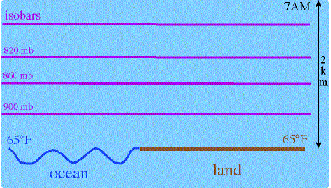
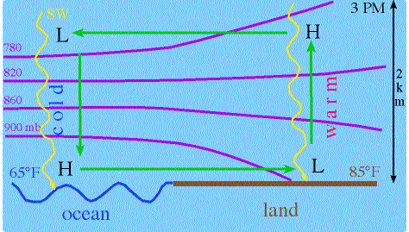
The Sea/Land Breeze Circulation
Produced by differential heating at the land/water interface when synoptic-scale forcing is absent or weak
It’s very “ageostrophic”
Return flow
Cool, moist sb

Slide 4
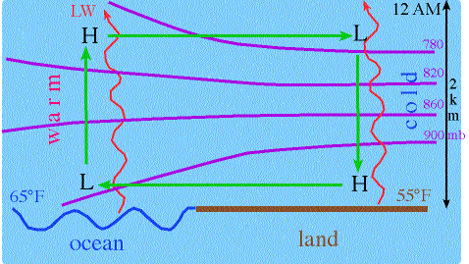
The Sea/Land Breeze Circulation
The land breeze during the evening hours sets up and is often weaker than the sea breeze
Return flow
Land breeze

Slide 5
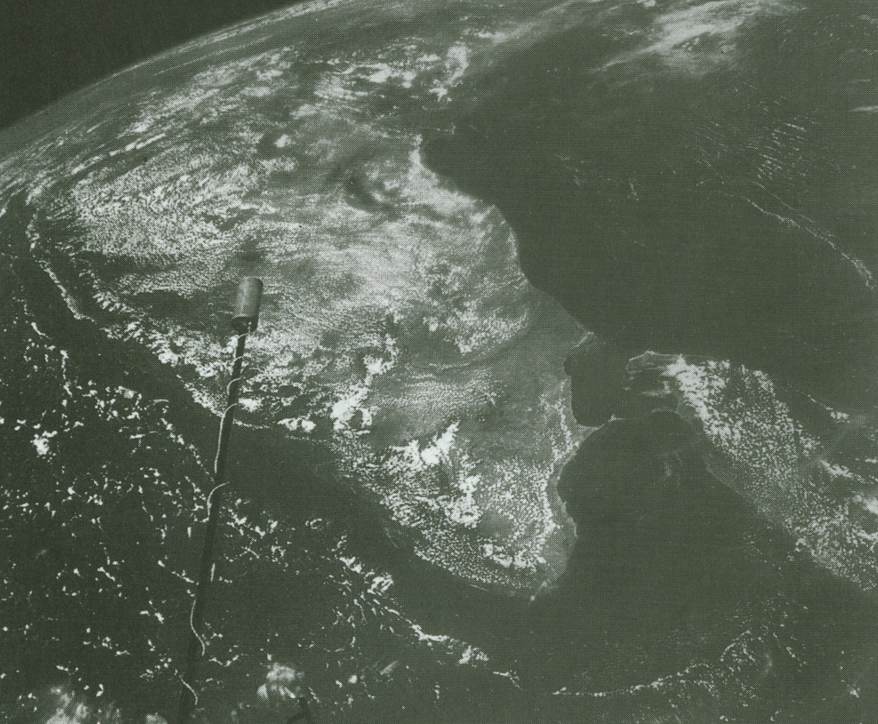
Satellite Observations
From Simpson (94)
Note coastal clearing and clearing off the coast due to subsidence in the return flow

Slide 6
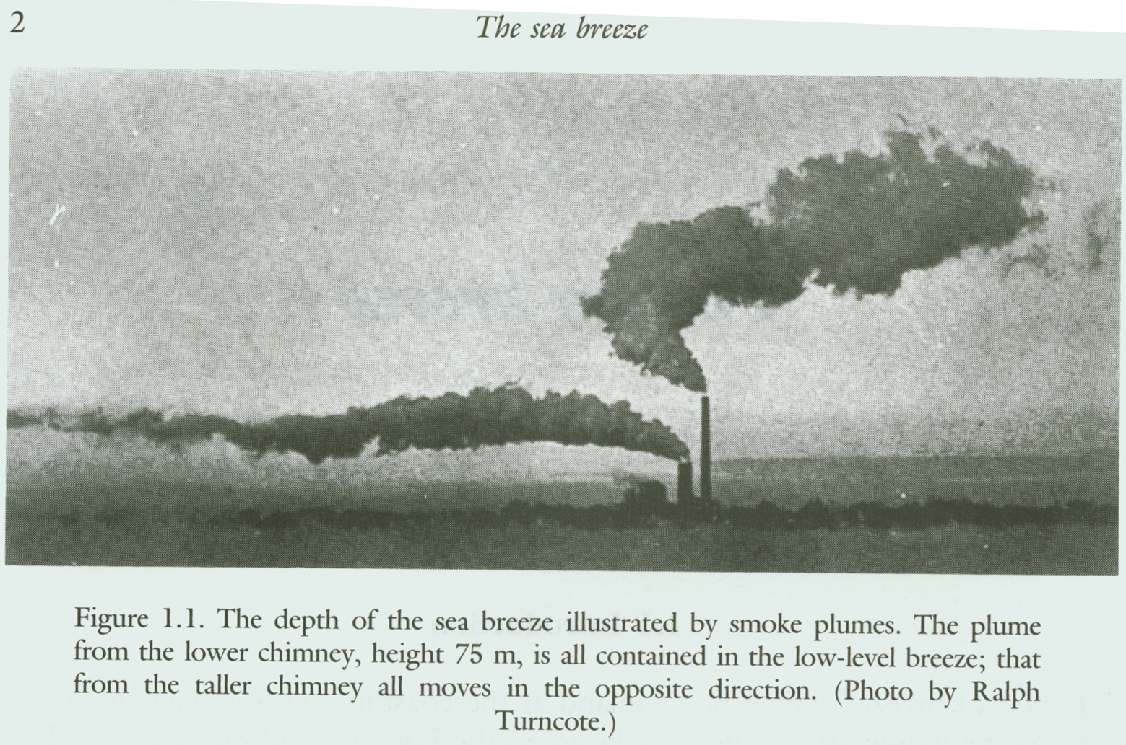
From Simpson (94)
Note the shallow low-level sb flow (onshore) and the upper return flow in these smoke plumes

Slide 7
Surface Observations:
At the surface, passage of the sea breeze is characterized by:
A temperature drop from 0 – 5-10 deg. C
Change in wind speed and/or direction
Moisture increase
Pressure often does not change much, if at all

Slide 8
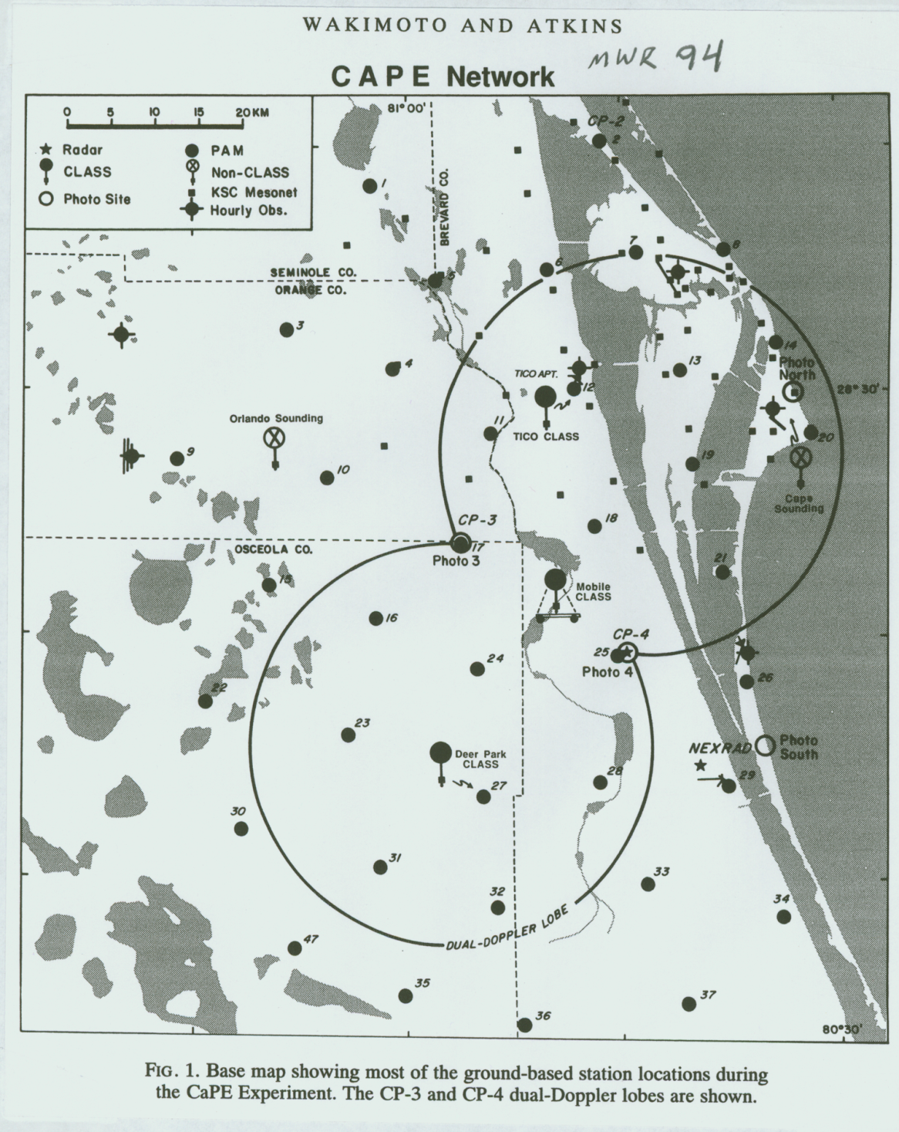
Observations during CaPE

Slide 9
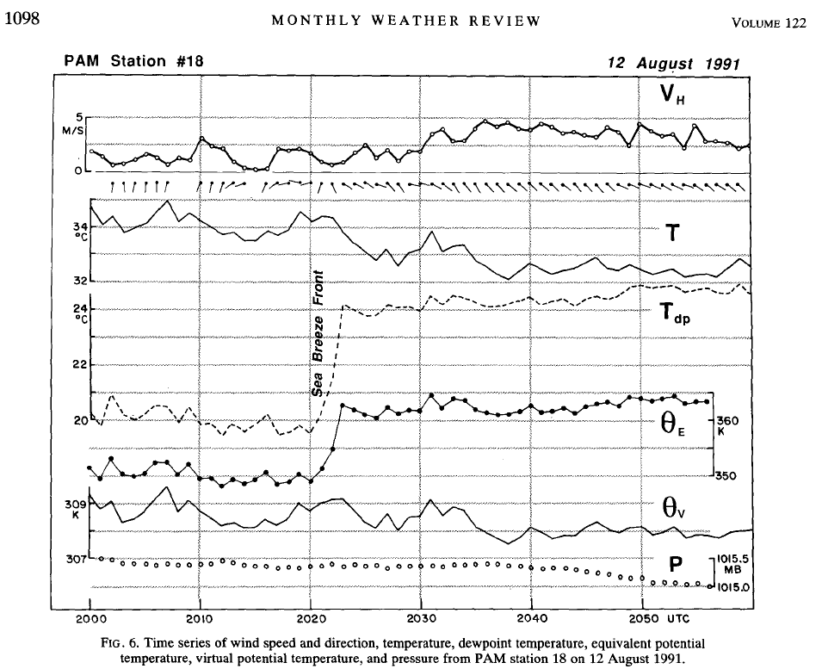
Observations during CaPE
From Wakimoto and Atkins (94, MWR)

Slide 10
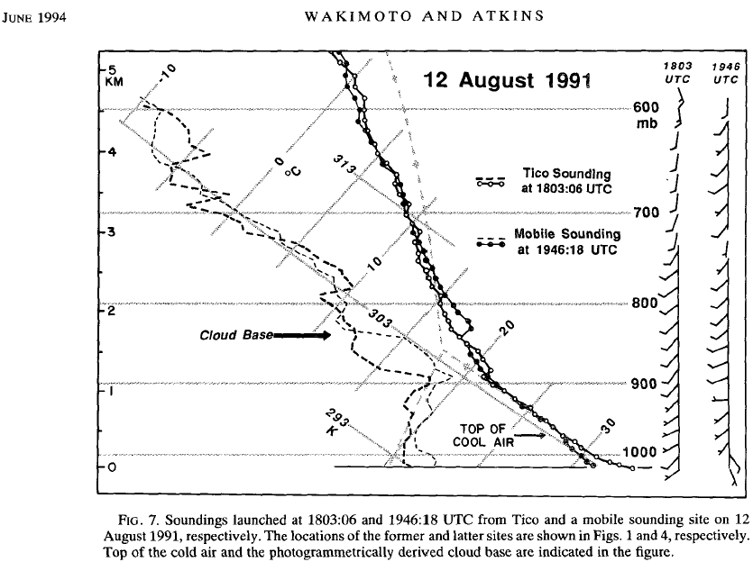
Observations during CaPE
Q: How deep is the sea breeze flow?
A: Typically 300-500 meters, sometimes deeper

Slide 11
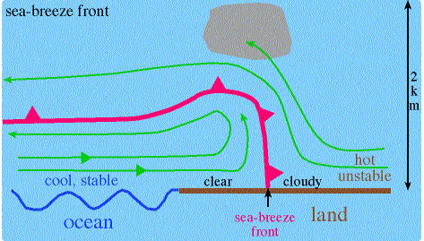
Sea Breeze Fronts
Often, a sea breeze front will form at the leading edge of the circulation
Looks like a mini, sharp cold front

Slide 12
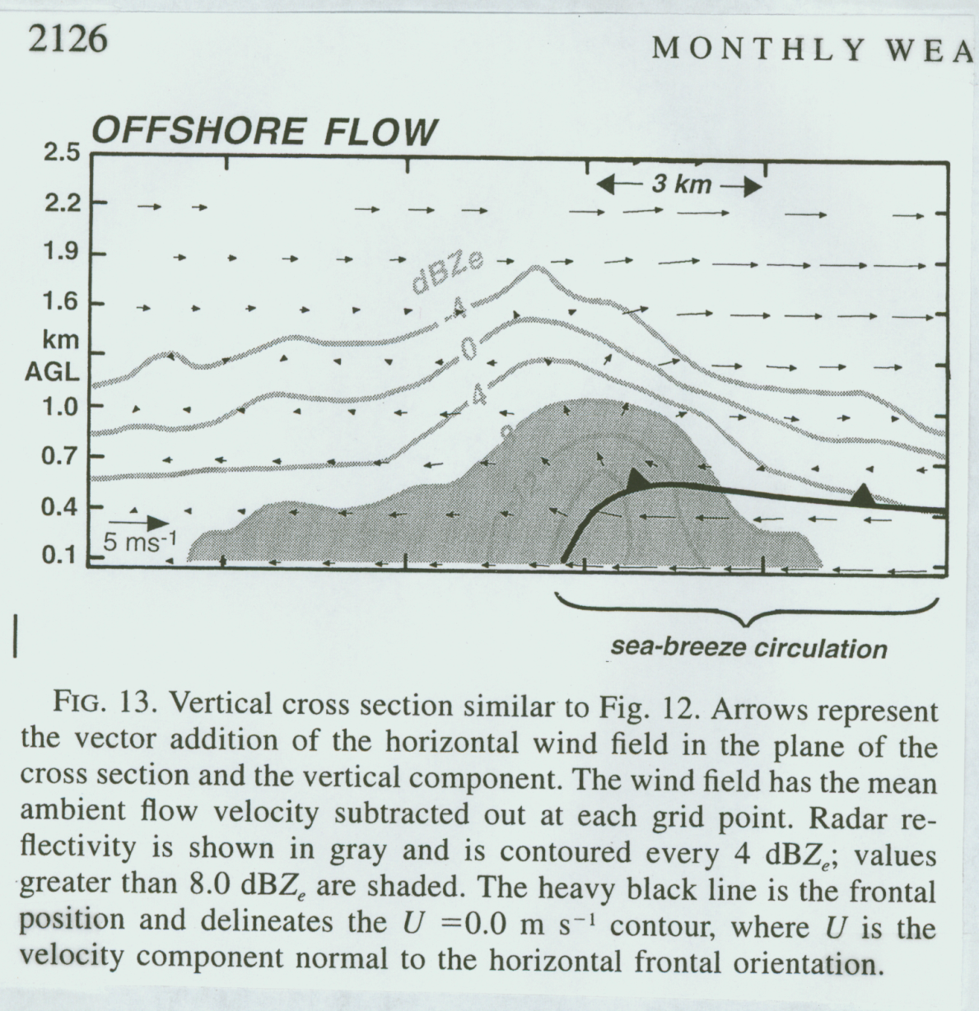
Observations during CaPE
Frontal Characteristics:
ΔT: 0 – 5-10 deg. C
Div: on order of -10⁻³ s⁻¹
W: 1-3 ms⁻¹
Often collocated with a radar-detected “thin line”
From Atkins and Wakimoto (97)

Slide 13
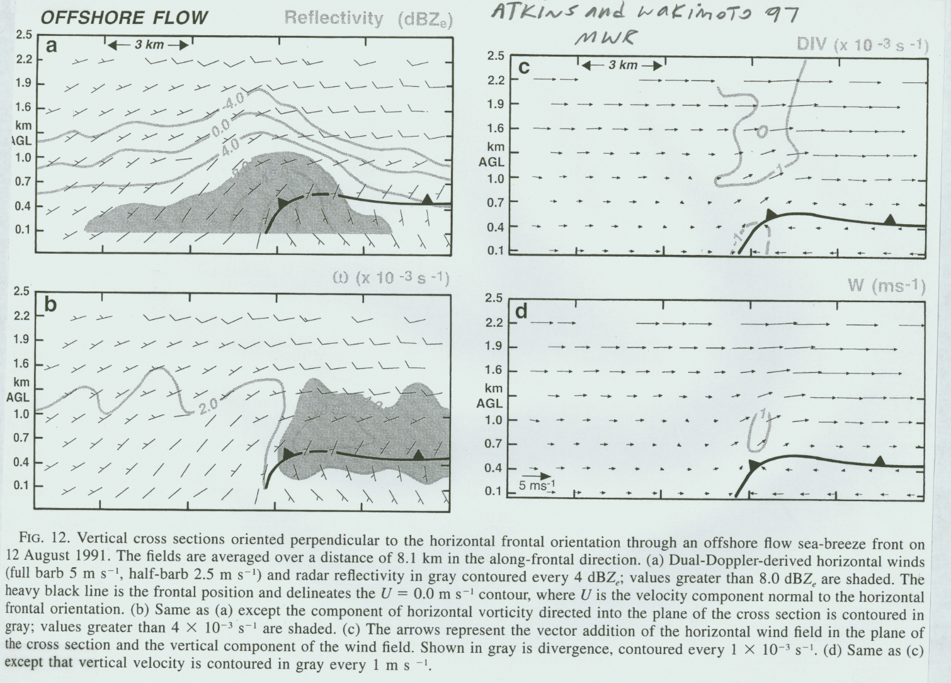
Offshore flow sea breeze

Slide 14
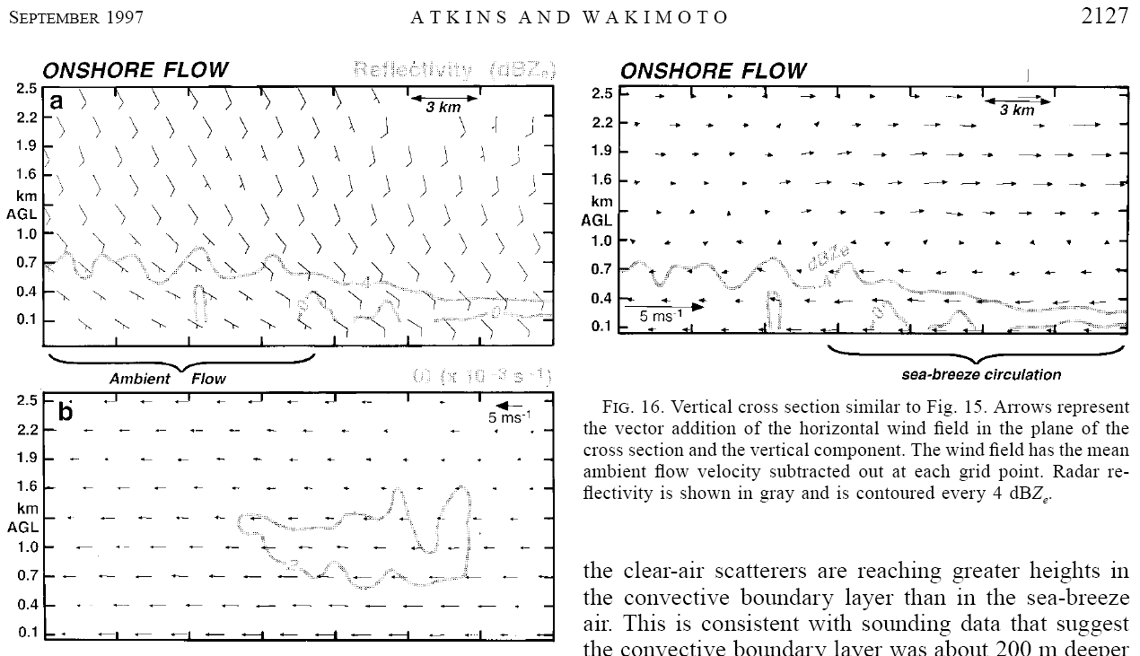
Onshore flow sea breeze

Slide 15
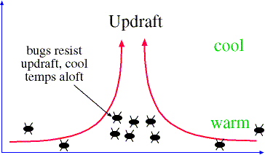
What’s up with the enhancement of dBZ at the sea breeze front?
Due to back scatter off of bugs and insects, not rain drops!

Slide 16
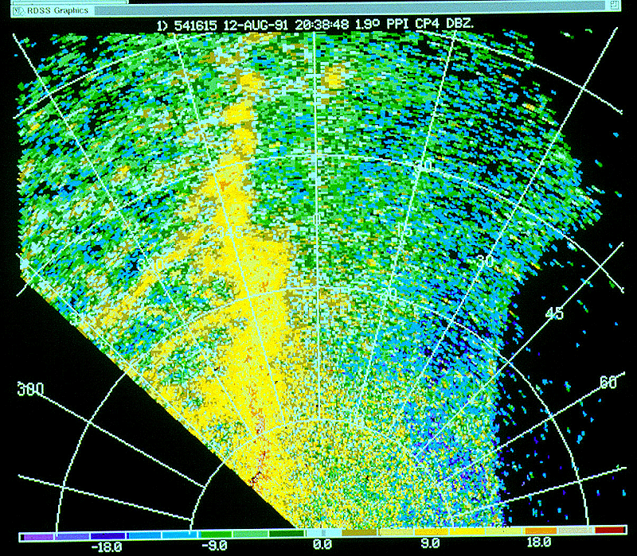
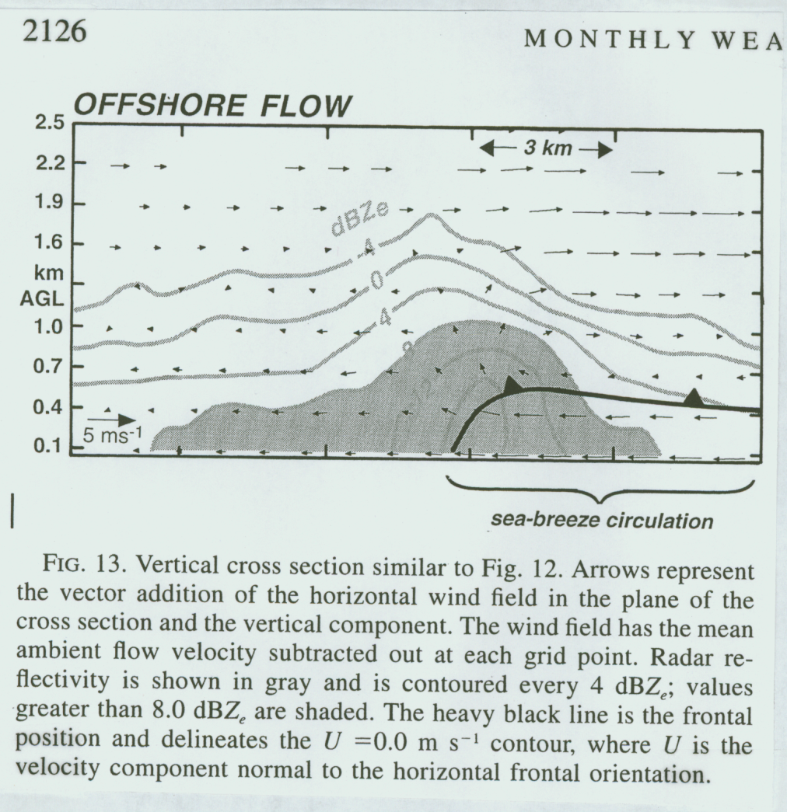
Sea breeze fronts and radar-detected “thin lines”

Slide 17
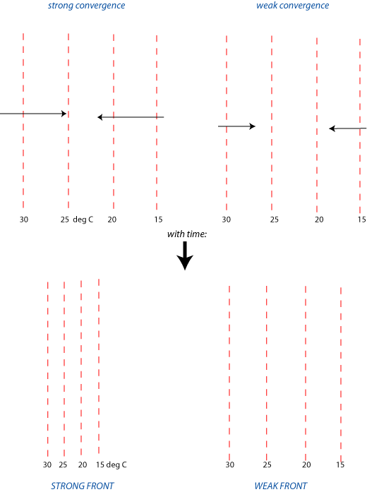
Sea breeze frontal strength - Frontogenesis
The primary frontogenesis mechanism for sea breeze fronts is convergence between the larger-scale ambient flow and the sea-breeze:
This would suggest that offshore flow days will produce stronger fronts than those observed during onshore flow

Slide 18
Offshore flow sea breeze

Slide 19
Onshore flow sea breeze
Notice that while the front is absent under onshore flow, the sea breeze circulation is still present!

Slide 20
Sea breeze frontal strength
Ultimately, sea breeze frontal strength is a balance between:
Convergence – frontogenesis
Turbulent mixing by boundary layer eddies: frontolysis
How does the sea breeze front and frontal strength evolve during the day as it moves inland?

Slide 21
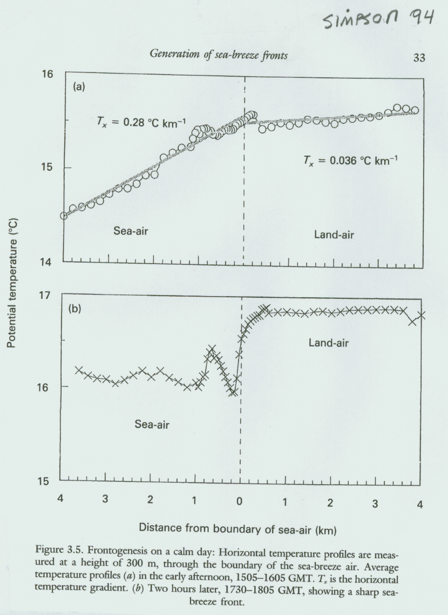
Sea breeze frontal strength evolution
Sea breeze is stronger later in the day as turbulent mixing shuts off

Slide 22
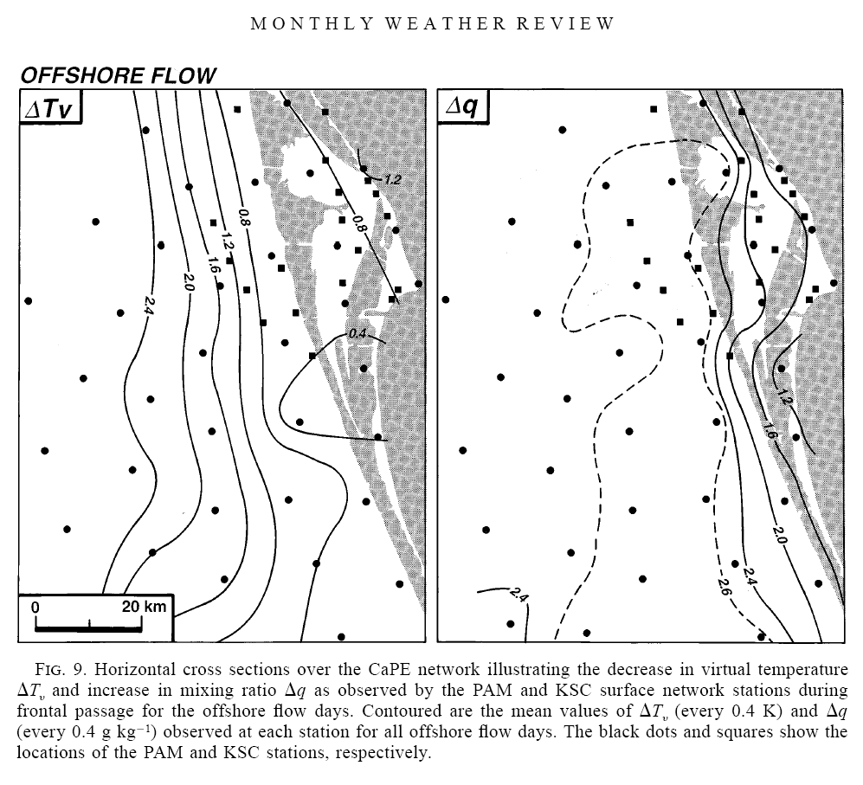
Offshore flow:
Notice how ΔTv and Δq increase inland
Presumably due to front getting stronger later in the day
From Atkins and Wakimoto (97)

Slide 23
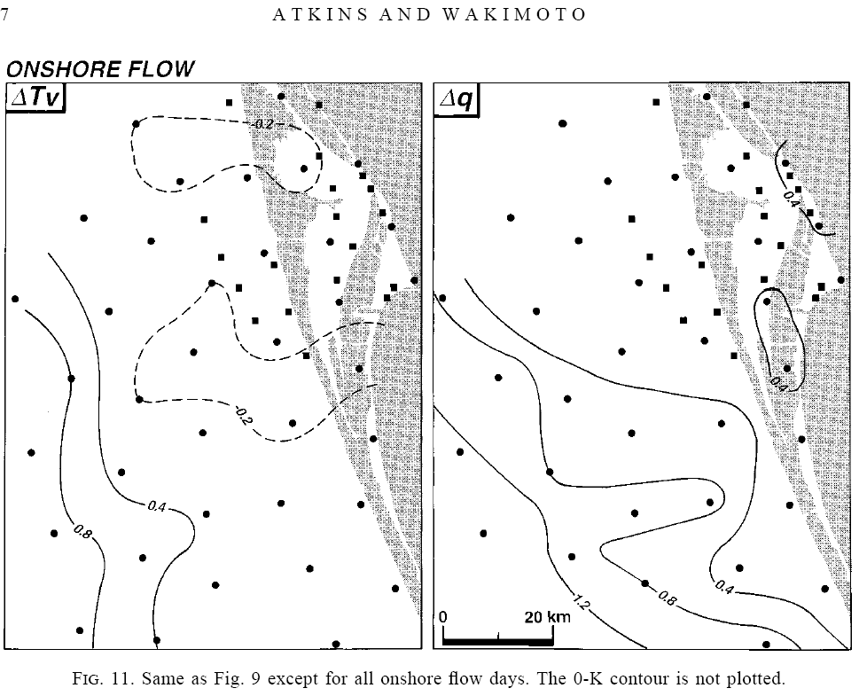
Onshore flow:
Notable difference relative to offshore flow??

Slide 24
The Sea Breeze – Forecast issues
Time of onset is important
Inland penetration distance – how far will it go?
The above two factors are important in determining max temperature at a give location since it often occurs just prior to sea breeze front arrival
Convective initiation

Slide 25
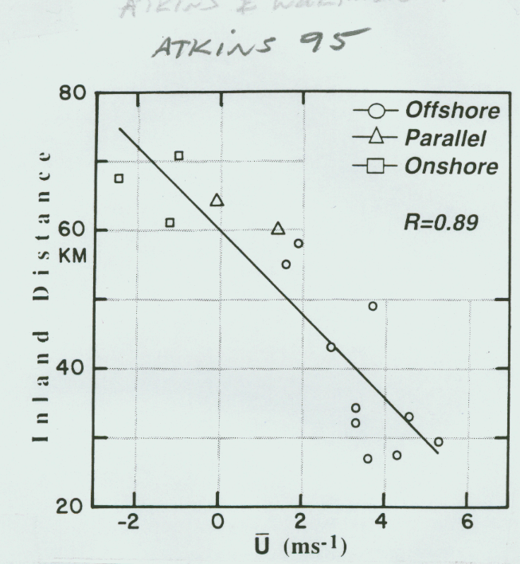
The Sea Breeze – Inland penetration distance
The inland penetration distance of the sea breeze is a function of:
ΔT
Strength of the opposing flow

Slide 26
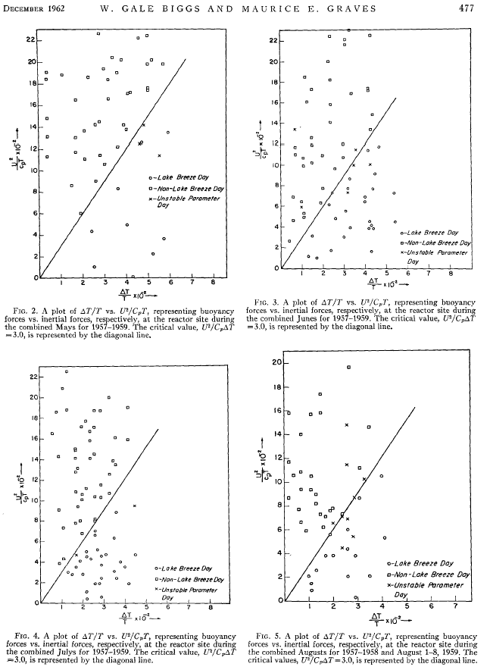
Data for Lake Breezes

Slide 27
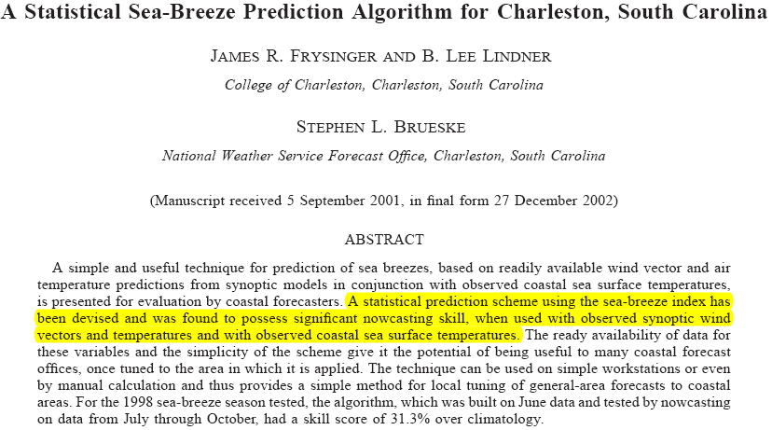
WAF

Slide 28
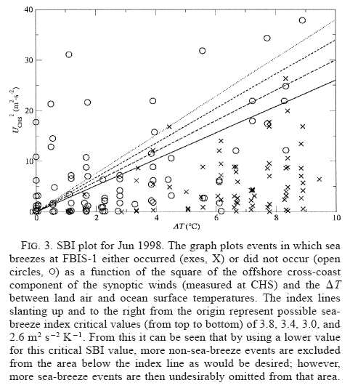
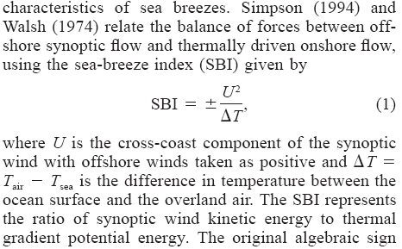
Frysinger et al. 02 - WAF

Slide 29
Movement of the sea breeze
Fundamentally, how does the sea breeze circulation move, anyway?
It is hypothesized with much supporting data that the sea breeze frontal movement is determined by density current dynamics:
Density current defined:
The horizontal flow of a heavier, more dense fluid into a lighter, less dense fluid
Studied extensively in the laboratory

Slide 30
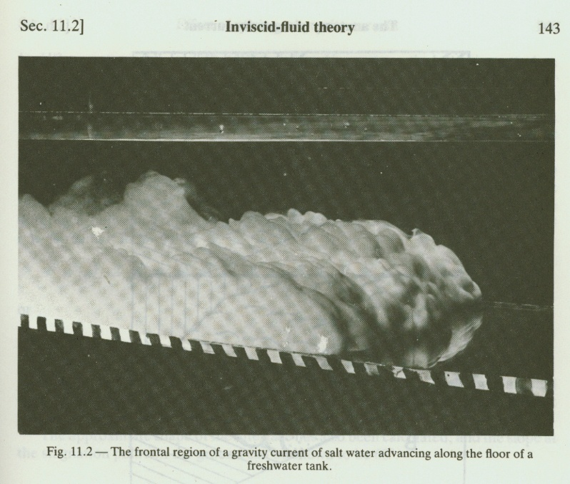
Density Currents:
Salt water moving along the floor of a fresh water tank
From Simpson (87)

Slide 31
Anatomy of a density current:
Head
Nose
Turbulent wake
depth

Slide 32
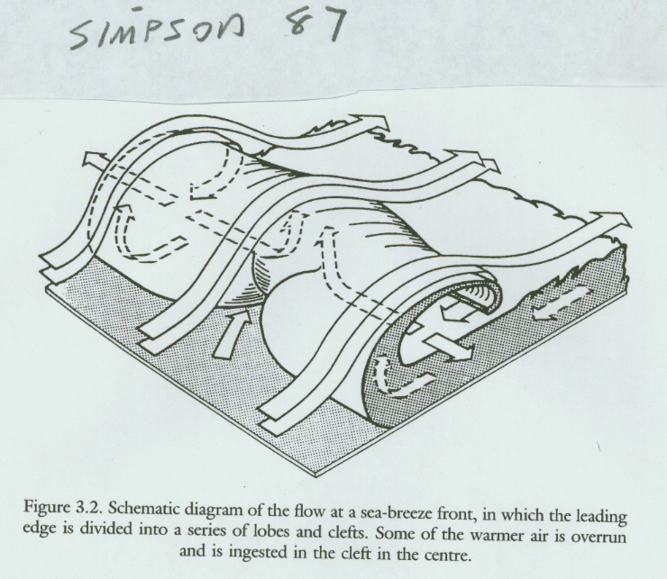
Instabilities on the density current head
Cleft-lobe (gravitational) instability
Produces a pattern of clefts and lobes on the leading edge of the gravity current
Produced as warm air (water) undercuts the cold air (salt water) at the surface below the nose:
From Simpson (87)

Slide 33
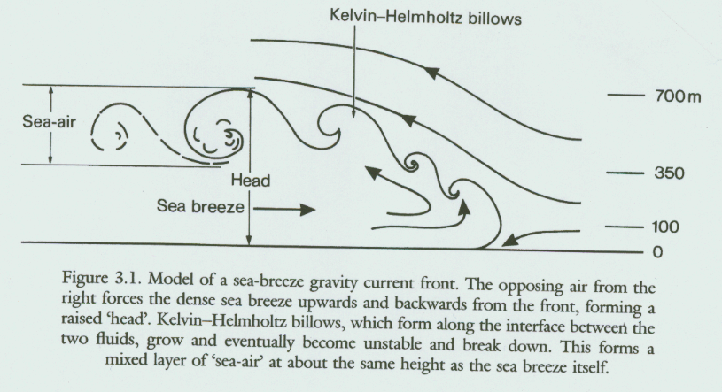
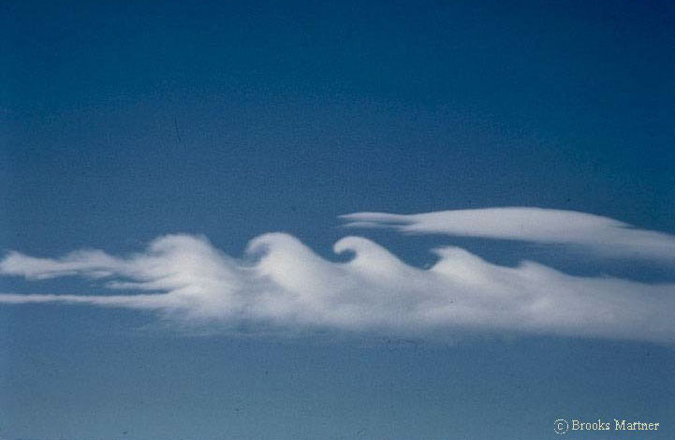
Instabilities on the density current head
Kelvin-Helmholtz billows – shearing instability
Form on top of the density current head due to shear at the interface with the ambient flow
From Simpson (87)

Slide 34
Density current propagation speed
Laboratory experiments have shown that the propagation speed of a density current is given by:
Where:
Κ = froude number = 0.78
d = depth of gravity current cold air

Slide 35
Density current propagation speed
In the presence of an ambient flow:
Where:
b = 0.7
U_{a} is the speed of the ambient flow (negative if it opposes the density current)
Ambient flow

Slide 36
Is the sea breeze moving like a density current?
You need to measure ρ_{c}, ρ_{w}, d, and the amient flow
This can be done with two soundings, one ahead and one behind the density current head.
You also need the density current propagation speed (isochrone analysis)
Ambient flow

Slide 37
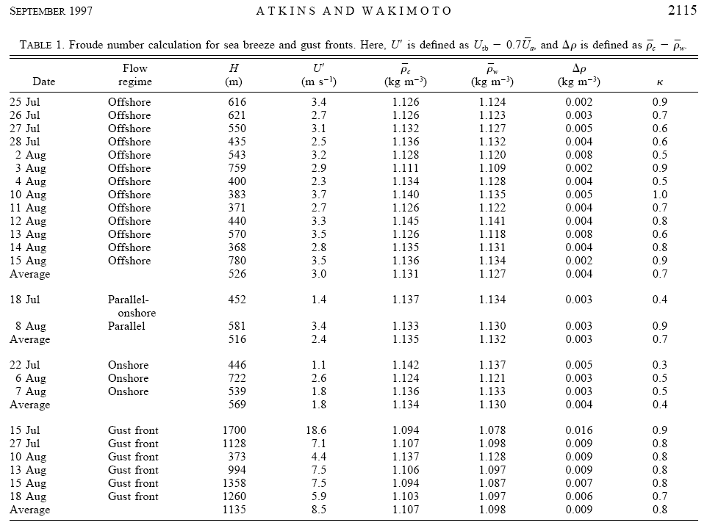
Is the sea breeze moving like a density current?

Slide 38
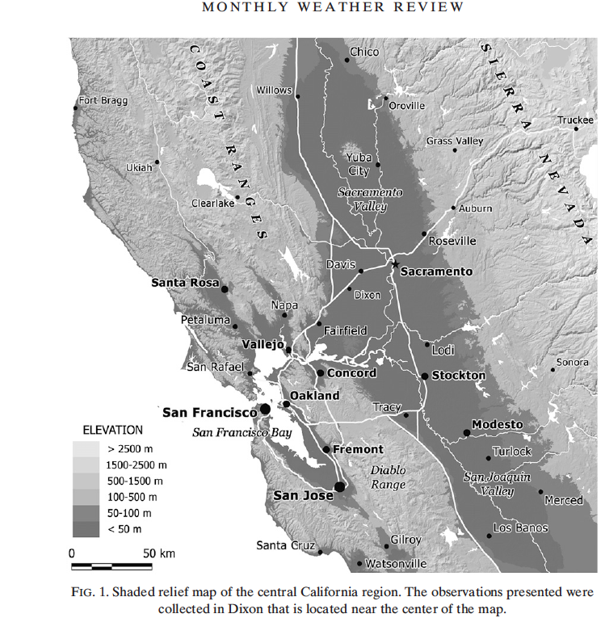
High resolution lidar observations of a thermal circulation in Central CA
Observations were taken near Dixon, CA
Lidar scanning in PPI and RHI modes

Slide 39
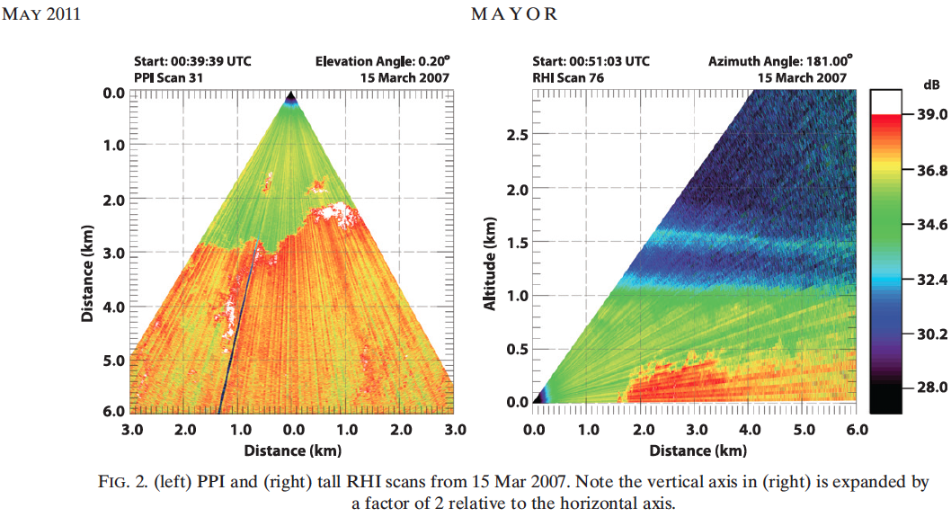
High resolution lidar observations of a thermal circulation in Central CA
Note depth of thermal circulation – backscatter off of aerosols in boundary layer
Turbulent wake region on head
Evidence of cleft lobe structure in PPI
Very sharp frontal boundary

Slide 40
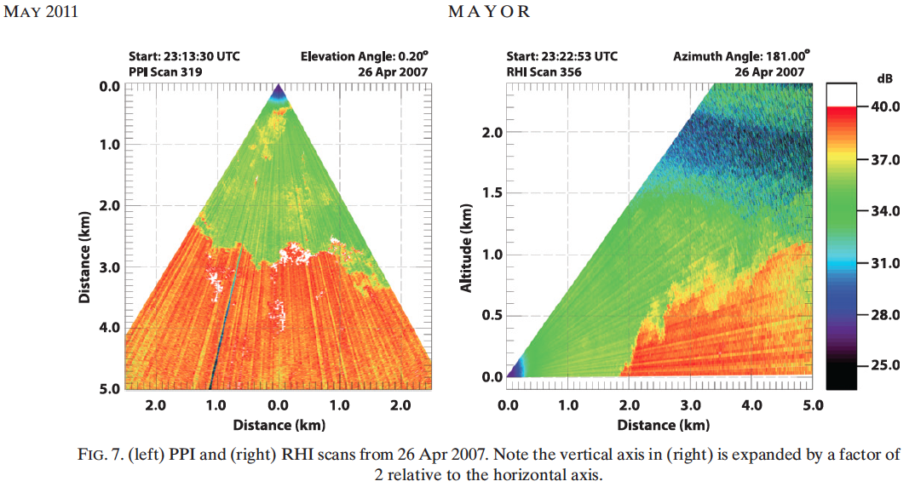
High resolution lidar observations of a thermal circulation in Central CA
Note depth of thermal circulation
Turbulent wake region on head
Evidence of cleft lobe structure in PPI
Very sharp frontal boundary
Calculations showed that it was moving like a density current

Slide 41
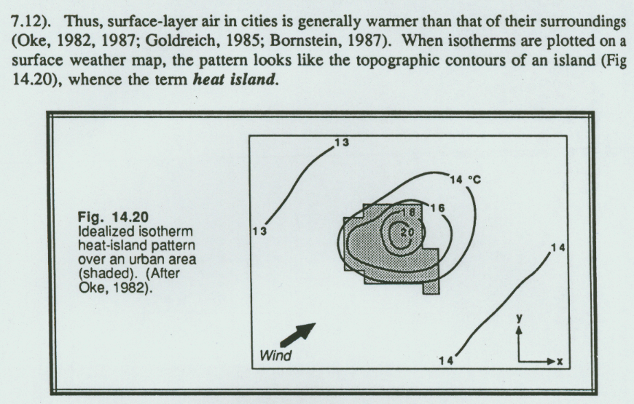
The Urban Heat Island Effect
Created by the lower albedo, higher heat capacity in the city relative to the surrounding rural area
POPULATION ΔT
1,000 2-3 degrees C
1,000,000 8-12 degrees C
The heat plume can extend downwind of the city
From Stull (91)

Slide 42
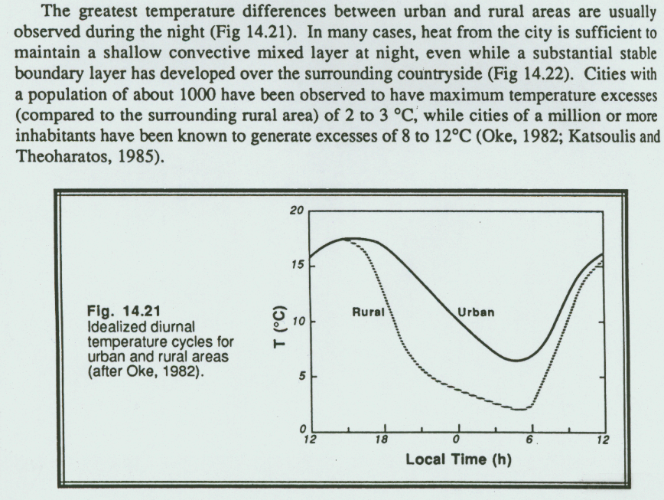
The Urban Heat Island Effect
The temperature difference is greatest at night
Why? Can have a shallow mixed layer in the city at the surface – keeps temps from falling
More radiational cooling occurs over the rural area – possibly related to the increased aerosols in the city
The increased aerosols also help to keep cities climatologically a bit more cloudy
From Stull (91)

Slide 43
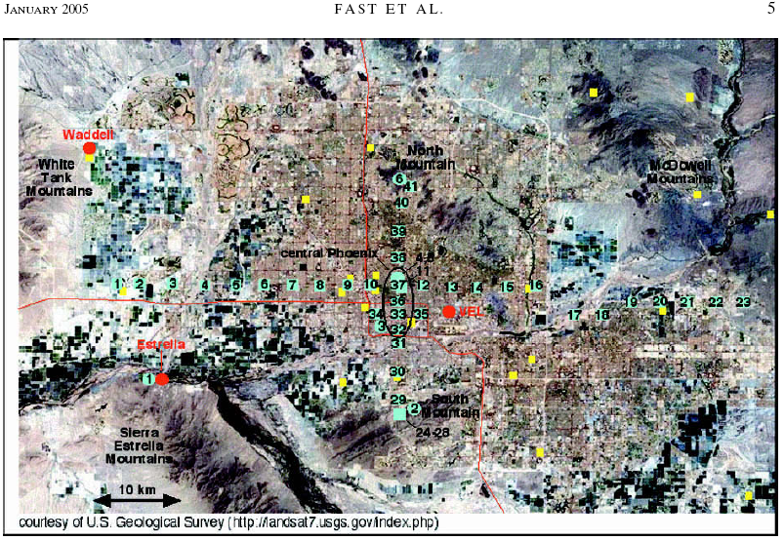
The Urban Heat Island Effect
Study for the Phoenix, AZ area
From Fast et al. 05 - JAM

Slide 44
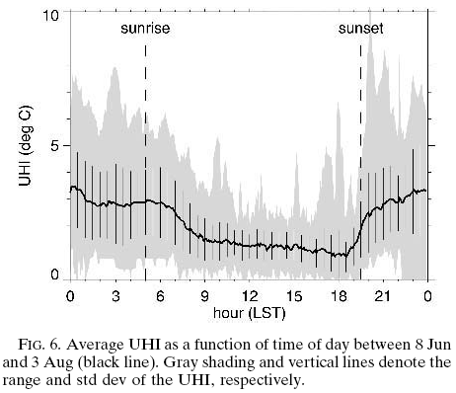
The Urban Heat Island Effect
From Fast et al. 05 - JAM

Slide 45
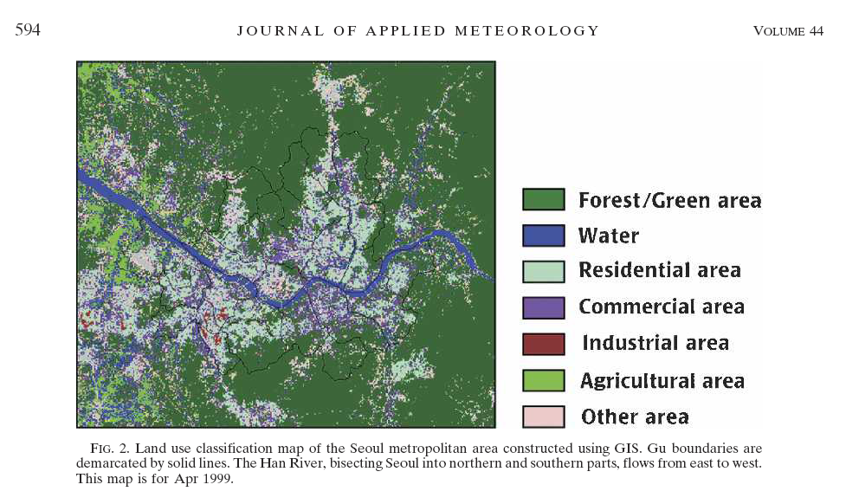
The Urban Heat Island Effect
From Kim and Baik 2005, JAM

Slide 46
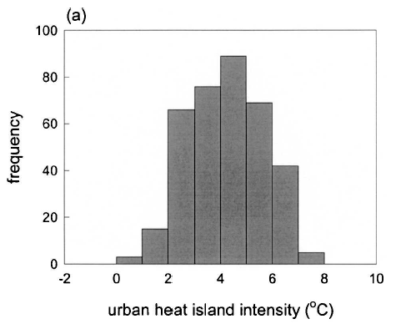
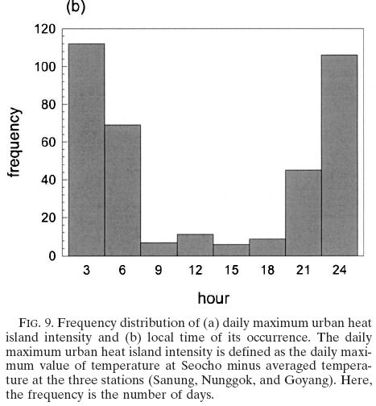
The Urban Heat Island Effect Timing and Intensity for Seoul
From Kim and Baik 2005, JAM

Slide 47
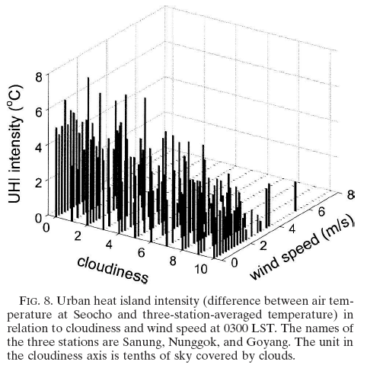
The Urban Heat Island Effect
Notice the effect of cloudiness and wind speed on UHI
Does the graph make physical sense?
From Kim and Baik 2005, JAM

Slide 48
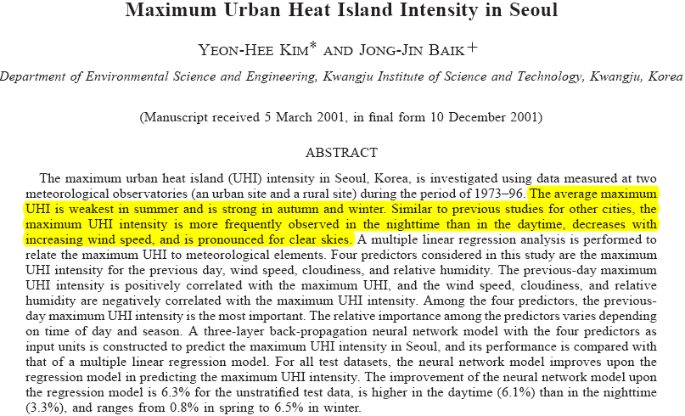
The Urban Heat Island Effect
From Kim and Baik 2002, JAM

Slide 49
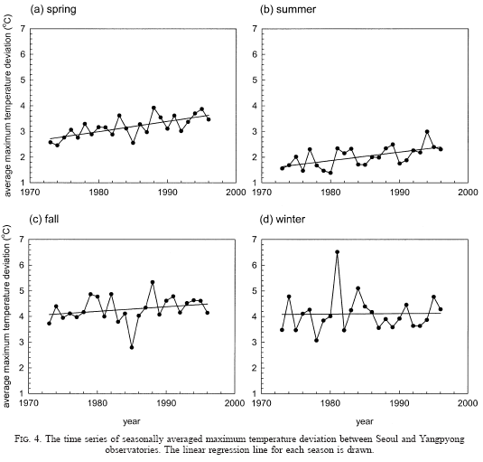
The Urban Heat Island Effect
Heat island effect has seasonal variation…., and appears to be increasing during most seasions.
From Kim and Baik 2002, JAM

Slide 50
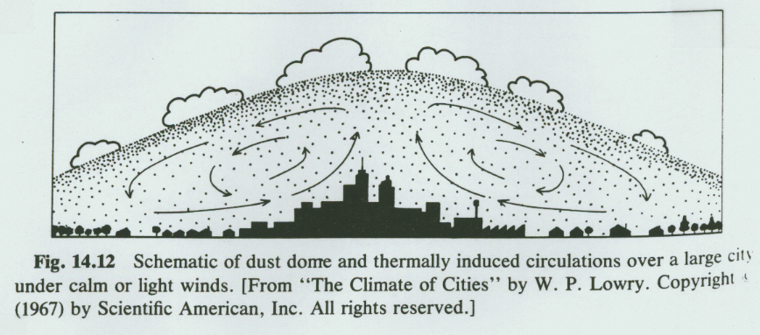
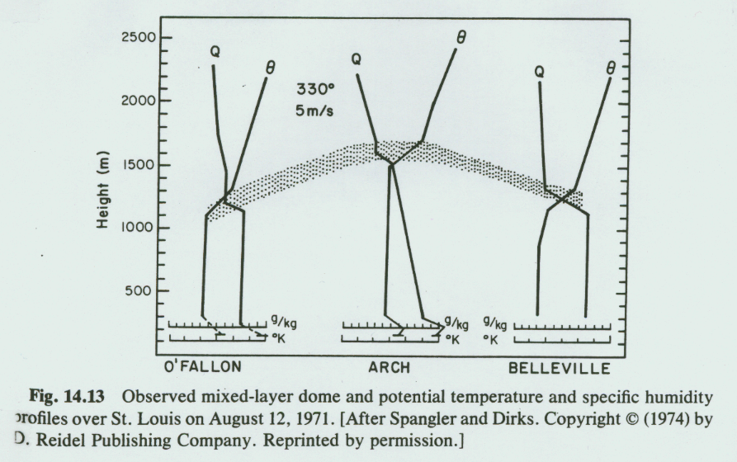
The Urban Heat Island Effect
Generates a thermal circulation and locally deeper boundary layer in the city
From Stull (91)

