Slide 1
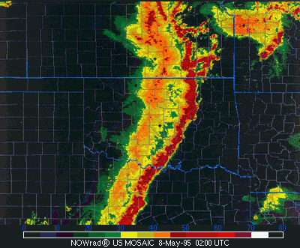
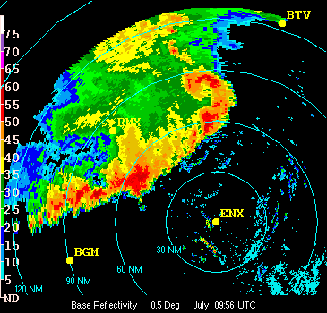
Squall Lines
Loosely defined: A line of either ordinary cells or supercells of finite length (10- hundreds of km) that may contain a stratiform rain region either behind, parallel to, or ahead of the convective line.
Most of the time, the stratiform rain region is behind the convective line
Long lived
Often are quasi-2D (linear) but can contain three-D structure

Slide 2
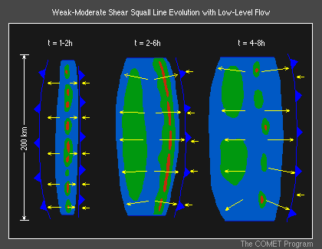
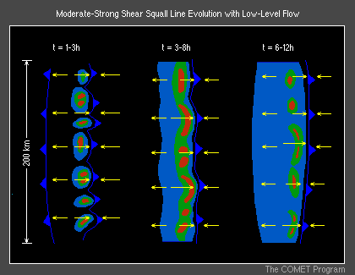
Conceptual model of squall line evolution
Weak, moderate shear:
New cell development on downshear side of cold pool
Meso high behind gust front – created by cold pool
Associated wind field produced by meso high
Gust front surges outward, system decays at later times
Well defined stratiform rain region forms
Moderate-strong shear
Notice that the cells tend to be stronger
Some embedded bowing segments possible
Meso high is closer to gust front than for weak shear
Not much of a stratiform rain region forms
Longer lived than weaker shear lines
Gust front does not surge outward

Slide 3
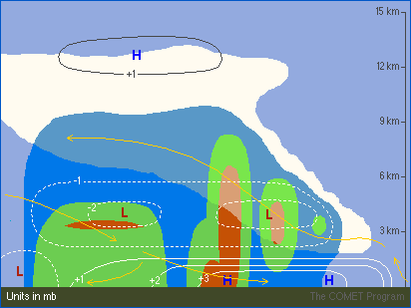
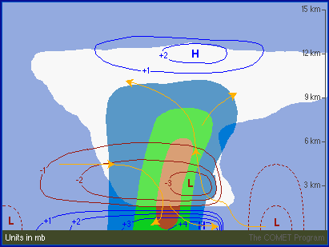
Vertical circulations and pressure patterns within squall lines

Slide 4
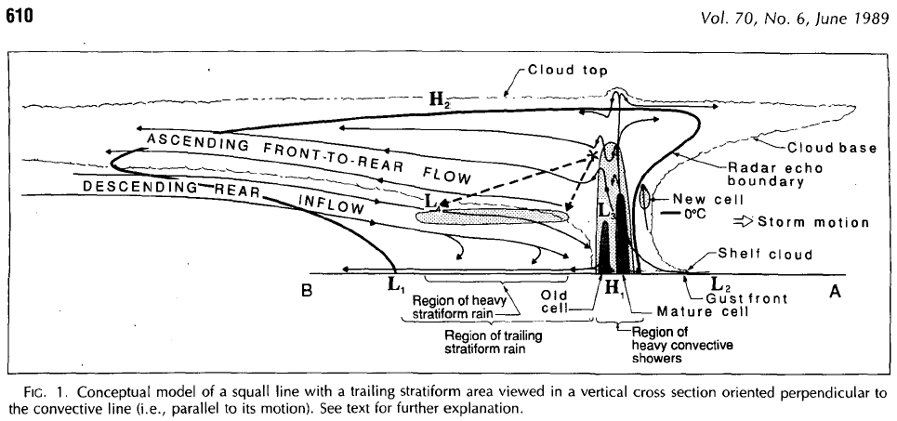
Vertical circulations and pressure patterns within squall lines
From Houze et al. (89) BAMS

Slide 5
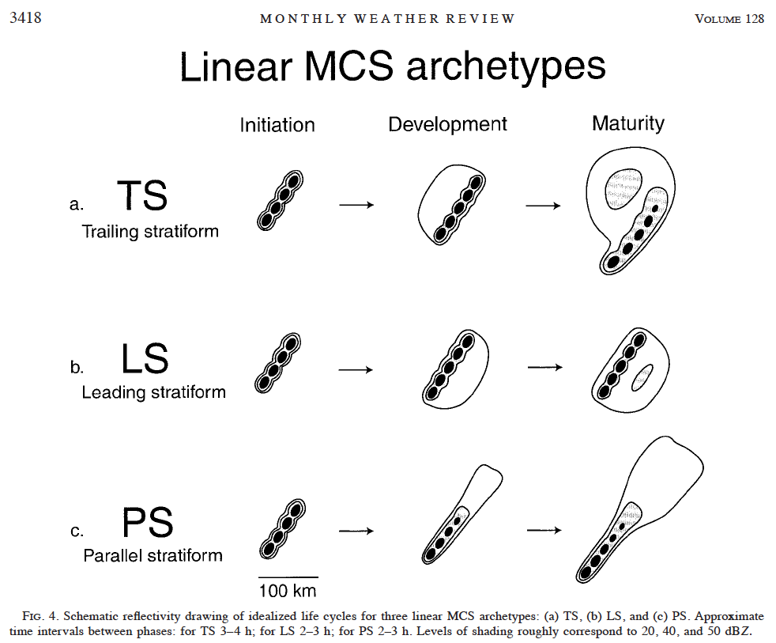
From Parker and Johnson 2000 - MWR
Squall Line Archetypes

Slide 6
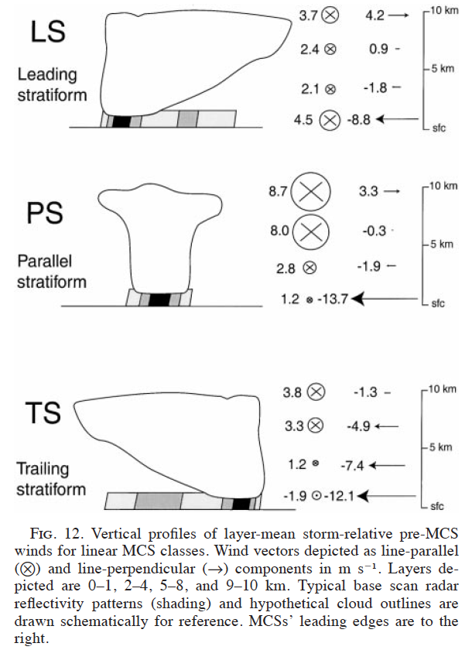
Note differences in parallel and perpendicular vertical shear profiles for each of the three types.
What’s notably different in the three profiles?

Slide 7
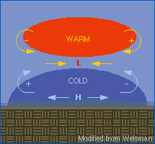
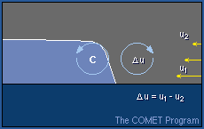
What are the important physical processes that create, maintain, and explain the evolution of squall lines?
Note the relationship between negative and positive areas of buoyancy and pressure and resultant horizontal accelerations:
Cold pool-shear interaction that has been previously discussed:

Slide 8
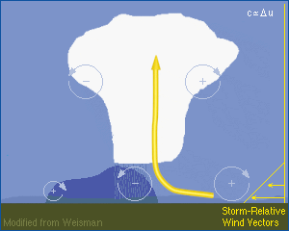
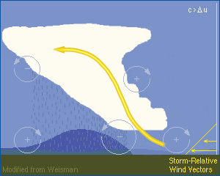
2-D evolution:
Initially, the updraft tilts downshear as the shear in the ambient flow is not balanced.
As the convection produces precipitation, a cold pool is produced.
The horizontal vorticity associated with the cold pool begins to balance the low-level shear in the environment, i.e., c/Δu = 1
Therefore, the updraft becomes upright and the convective cells are quite strong.
As the cold pool gets stronger, it’s horizontal vorticity becomes larger than that in the low-level environmental shear, i.e., c/Δu > 1
Therefore, the updraft tilts upshear, creating the front-to-rear flow

Slide 9
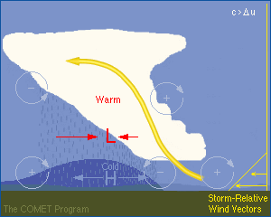
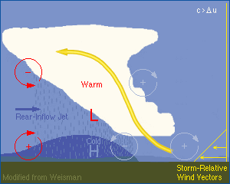
Squall line 2-D evolution
Since the updraft is associated with warm, positively buoyant air and the cold pool with negatively buoyant air, a meso low is created underneath the warm ascending front to rear updraft and a meso high is created within the cold pool
The meso low creates a horizontal pressure gradient that accelerates air at mid levels from the rear of the system to the leading edge.
This current of air is called the rear-inflow

Slide 10
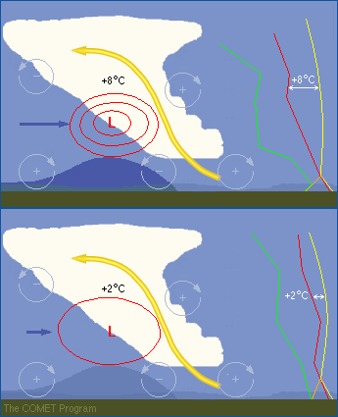
Squall line 2-D evolution
If the updraft contains very warm, positively buoyant air, the meso low will be very strong and generate a very strong rear inflow – called a rear inflow jet.
This will happen when the CAPE is quite large
The rear inflow will, therefore, be weaker when the CAPE is smaller.

Slide 11
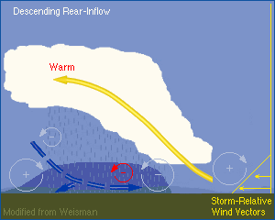
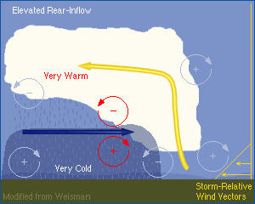
If the buoyancy gradient associated with the warm air in the ascending FTR flow is less than the buoyancy gradient on the back edge of the cold pool, then the RIJ will descend to the ground well behind the leading edge of the system
This often occurs when the environmental shear is weak-moderate
When the buoyancy gradient associated with the warm air in the ascending FTR flow is similar in magnitude the that with the back edge of the cold pool, the RIJ will tend to remain elevated and descend when it reaches the leading edge of the convective system.
This often occurs when the environmental shear is stronger
This scenario is often associated with strong bow echo formation

Slide 12
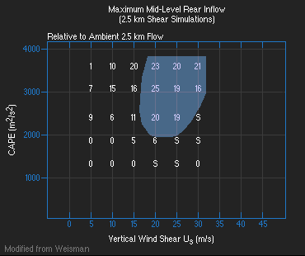
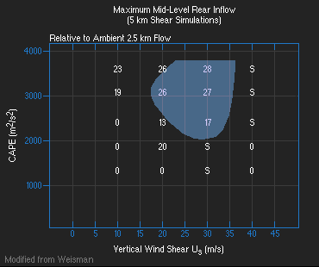
These results are based on numerical simulations:
What CAPE/shear values favor the development of stronger rear inflow?

Slide 13
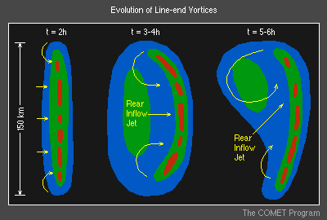
3-Dimensional Evolution
Later in the evolution of a squall line, it often evolves into an asymmetric, 3-D structure.
Numerical simulations have shown that when a squall line has a finite length (as they all do), larger-scale circulations form on the ends of the squall line
They are called line-end vortices
They can range in size from 10- a couple hundred km in scale
They are found behind the leading edge of the convective system, in the stratiform rain region at mid levels
How do they form?

Slide 14
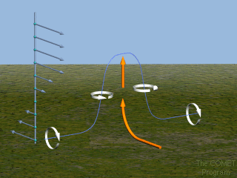
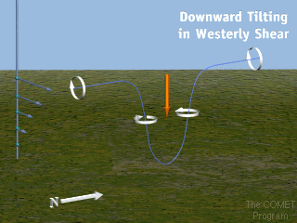
Line-end Vortex Formation
If you tilt westerly shear by an updraft (crosswise horizontal vorticity), you get a pair of circulations on either side of the updraft, but they are rotating the wrong way
If you tilt westerly shear by a downdraft, the (again crosswise horizontal vorticity), you get a pair of circulations rotating in the correct manner

Slide 15
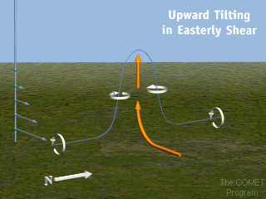
Line-end Vortex Formation
It is also possible to have the updraft tilt easterly shear generated at low levels (again crosswise horizontal vorticity)
The circulations will have the correct direction of rotation
How is this easterly shear create?

Slide 16
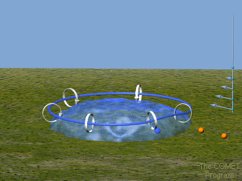
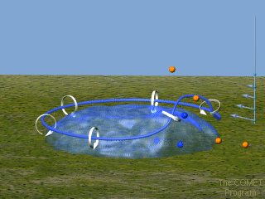
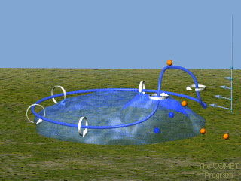
Line-end Vortex Formation
It’s generated by the cold pool
Numerical simulations have shown that the line end vortices form as the squall line updraft tilts upward the horizontal vorticity generated by the cold pool

Slide 17
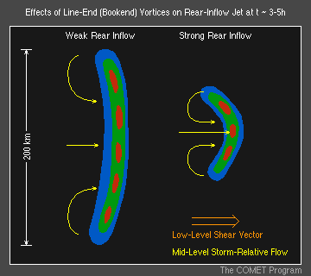
The line-end (often called book-end) vortices are, for smaller line segments, capable of enhancing the RIJ by as much as 30-50% (Weisman, 93, JAS)

Slide 18
With time, planetary vorticity enhances the northern (+) circulation and weakens the southern (-) circulation
Recall that the absolute vertical vorticity is the sum of relative vertical vorticity and planetary vorticity
This creates an asymmetric structure at later times, similar to observed squall lines.

Slide 19
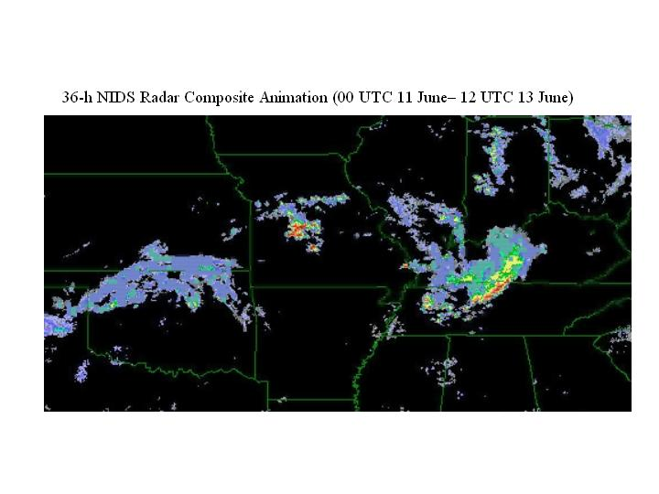
Squall lines that produce well-defined line end-vortices often produce MCVs (mesoscale convective vortices)

Slide 20
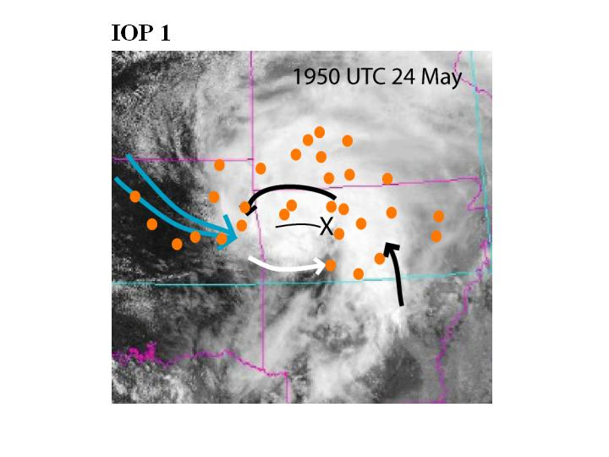
MCVs are often observed in satellite imagery after the primary convective system has or is dissipating
You can often see a swirl in the upper-level anvil debris cloud:

Slide 21
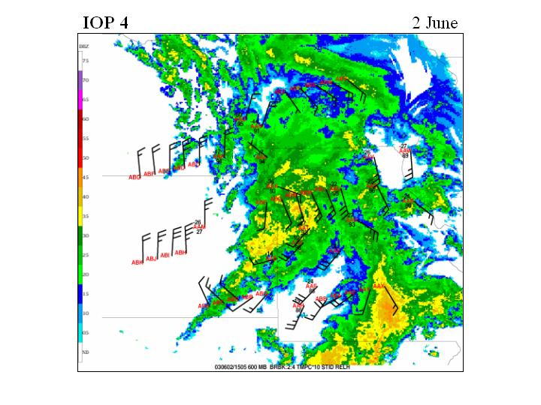
You can often see a swirl in the radar data as well

Slide 22
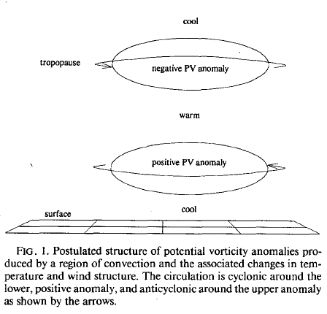
MCV formation by PV anomalies
reduced
increased
Warm anomaly created by latent heating in stratiform region behind leading edge of squall line
From Raymond and Jiang 90 - JAS

Slide 23
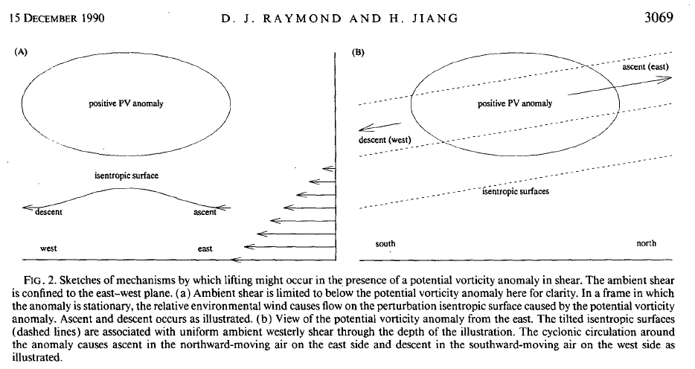
MCVs, vertical shear, and vertical motion

Slide 24
Why are MCVs important?
Long lived – often observed the day after the incipient convective system that produced the MCV initiated
Can affect precip distributions within MCSs
Can retrigger convection the next day (the day after it was produced)
Have been implicated in the genesis of tropical systems

