Slide 1
The Central Plains Nocturnal Low-Level Jet (Wind Maximum)
What is this???
Go to: www.mmm.ucar.edu/imagearchive and pull up:
Profiler data
National radar data
And select soundings for the time period 10-12 June, 2010

Slide 2
The Central Plains Nocturnal Low-Level Jet (Wind Maximum)
Why is the nocturnal LLJ important?
Convective initiation often results at the intersection of the LLJ nose and a synoptic/mesoscale boundary
Often leads to the formation of large MCSs – explains the nocturnal maximum of precipitation over the Plains States of the US.
Transports high equivalent potential temperature air northward
How does it form and why at night????
This discussion and figures follow Markowski and Richardson, 2010

Slide 3
Wind force balance during mid afternoon
Assumes lower pressure to the west – possibly due to lee trof/thermal low as higher terrain to the west heats up during the day
V_{h} is the actual horizontal surface wind
As cooling at the ground commences
During the evening hours, the boundary layer decouples as the surface cools
While the winds at the ground weaken significantly, within the developing inversion, this is not true in the upper parts of the nocturnal boundary layer and residual layers.
Therefore, friction is no longer important for the flow in the upper boundary layer
V_{g}
V_{h}
CF
PGF
F

Slide 4
As cooling at the ground commences
Therefore, friction is no longer important for the flow in the upper boundary layer
The flow that was in balance earlier in the day (PGF +CF+F = 0) is no longer in balance since F = 0.
Therefore, an inertial oscillation is generated to create ageostrophic flow that attempts to bring the flow back into balance.
This ageostrophic flow helps to create the LLJ.
V_{g}
V_{h}
CF
PGF

Slide 5
Theory
Once the flow is decoupled and friction is no longer impacting the flow in the upper boundary layer, the equations of motion are:
(1)
We will separate the wind velocity into it’s geostrophic and ageostrophic components:
u=u_{g} + u_{a}
v=v_{g} + v_{a} (2)
Substituting equations (2) into (1) and assuming that the geostrophic flow is constant in time (du_{g}/dt = 0 and dv_{g}/dt = 0) gives:
(3)

Slide 6
Theory, cont
We know from dynamics that:
(4)
Substituting (4) into (3) gives:
(5)
(6)
By taking d(6)/dt and substituting into (5) and d(5)/dt and substituting into (6) gives (do this yourself!!!):
(7)

Slide 7
Theory, cont
(7)
Equation (7) is an easy to solve ordinary differential equation that has a solution:
(8)
Where C₁ and C₂ are constants. They can be found by setting the following boundary conditions;
at t = 0, u_{a} = u_{a0} and v_{a} = v_{a0}
In doing so, one can show that C₁ = u_{a0} and C₂ = -v_{a0}. Substituting this result into (8) gives:
(9)

Slide 8
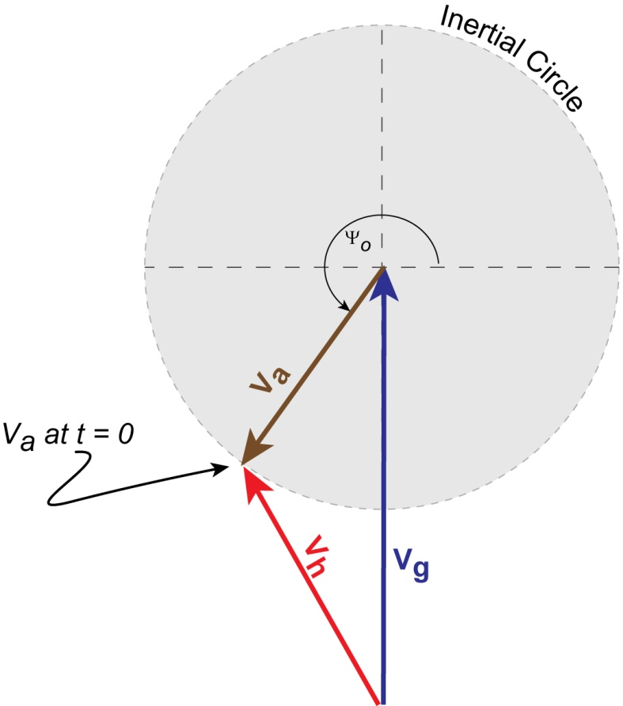
Theory, cont
(9)
Using trig rules, equation (9) can be written as:
(10)
where: and Ψ_{o} is the
orientation of the ageostrophic flow at t = 0.
Remember that V_{h} = V_{g} + V_{a}
In this example, the flow is sub geostrophic
During late afternoon.

Slide 9
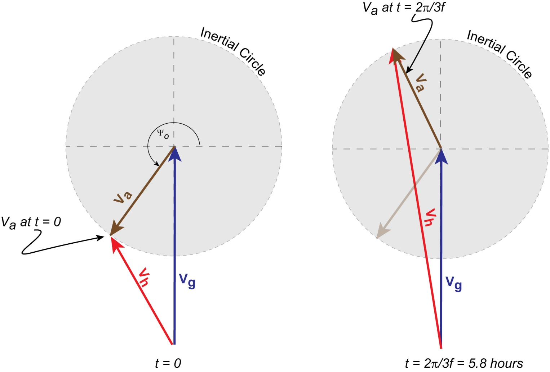
Theory, cont
As time continues, V_{a} moves around the inertial circle. In the example below, note that V_{a} + V_{g} gives a supergeostrophic flow (V_{h} > V_{g}) that is strong and southerly at 5.8 hours after the time the boundary layer first decouples.
Q: The LLJ is stronger when the inertial circle is larger. What produces a larger inertial circle?

Slide 10
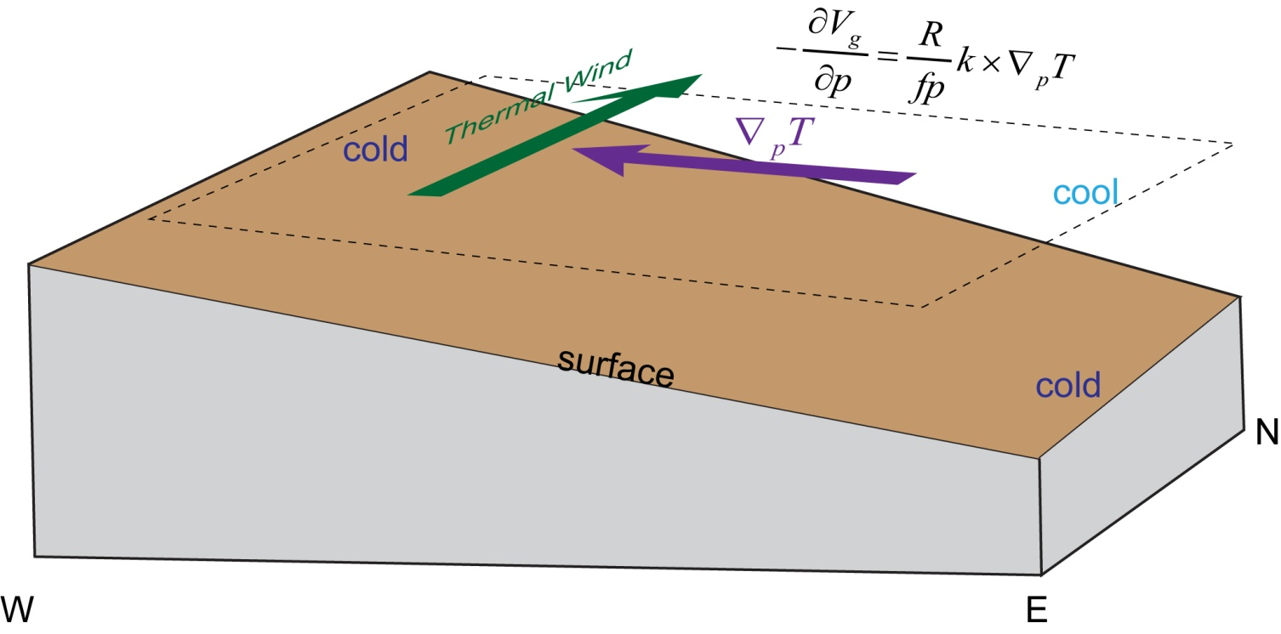
Effect of sloping terrain
Over the Central Plains, the terrain slopes upward as one moves to the west.
This can help to enhance the LLJ at night by producing a low-level southerly thermal wind:

