Slide 1
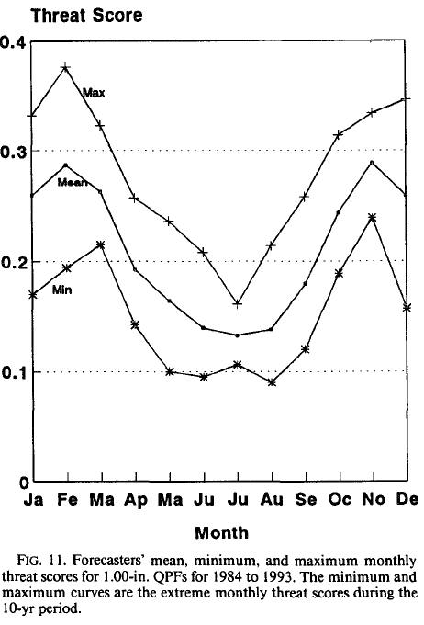
Convection Initiation
Convection initiiation – where and when will moist convection initiate
Why is this important?
  QPF (quantitative precipitation forecasting – where, when, and how much precip to forecast?)
  Summertime QPF skill is still quite low:
  Note that the Threat Score is defined as:
  TS = A_{c}/(A_{f}+A_{o}-A_{c})
  Where:
  A_{f} = area of precip forecast
  A_{o} = area of observed precip
  A_{c} = area correctly forecast (overlap area)
  So if TS is small, forecast is bad
  If TS = 1, it was perfect
From Olson et al. (95, wea forecasting)

Slide 2
Convection Initiation
Convection initiation – where and when will moist convection initiate
Why is this important?
  Severe weather forecasting (tornadoes, hail, high winds, lightning, flash floods)
  Hydrology
First studied in the early 80’s in support of nowcast efforts for microburst occurrence near airports

Slide 3
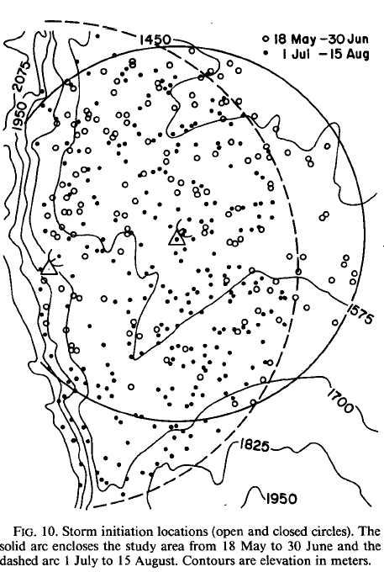
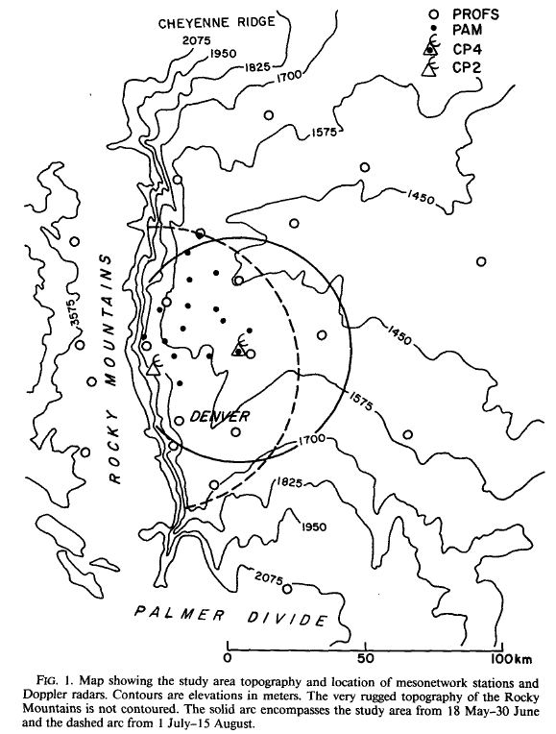
Both figures are from Wilson and Schreiber (86, mwr)
Note the random nature of thunderstorm initiation locations

Slide 4
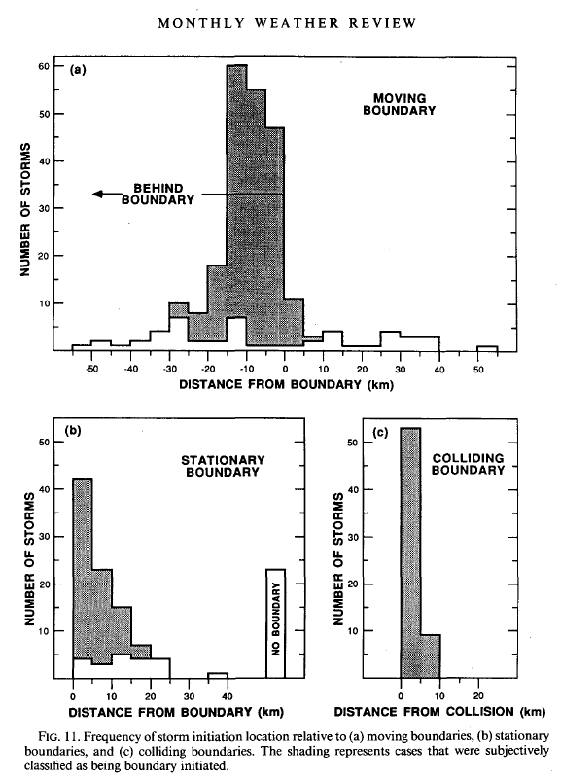
Relative to boundaries, however, their occurrence is not random
What types of “boundaries” are there?
Wilson and Schreiber (86, mwr)

Slide 5
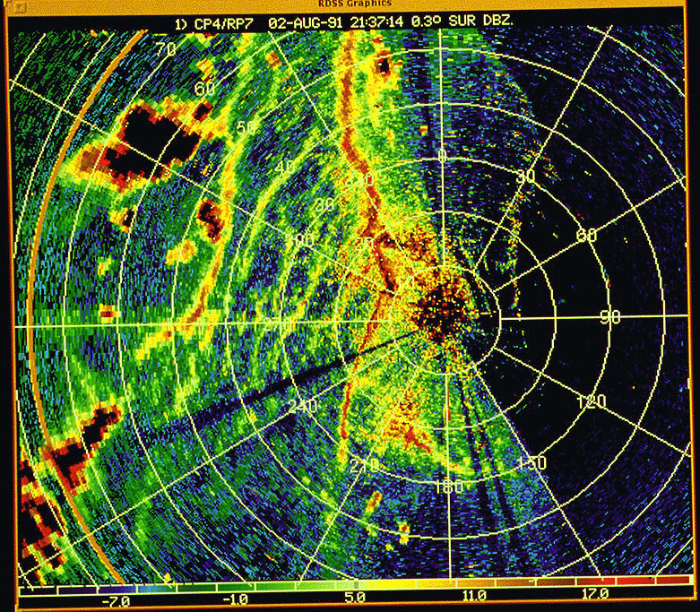
Sea breeze fronts
HCRs
Gust fronts

Slide 6
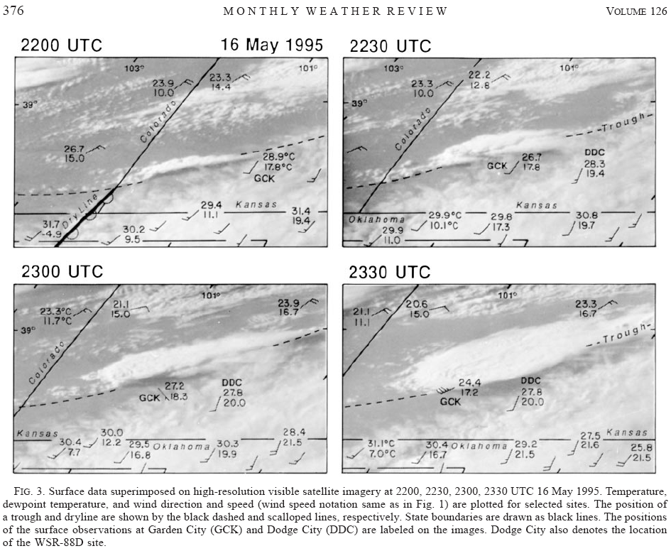
Troughs
Dryline
From Wakimoto et al. (98, mwr)

Slide 7
Boundaries in the boundary layer created by non homogeneous surfaces or surface conditions:
Low albedo | High albedo
Low soil moisture | High soil moisture
Small friction | Large friction
Low soil thermal capacity | High soil thermal capacity
Low elevation | High elevation
Urban | Rural
Also:
cloud/no cloud boundaries
Cold fronts, warm fronts

Slide 8
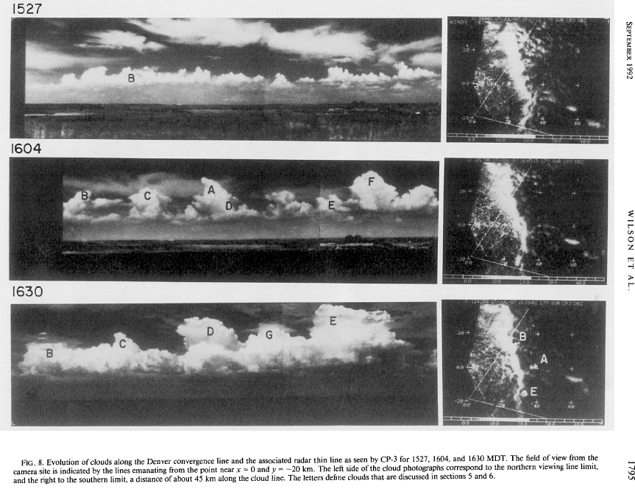
Topographically induced (DCZ) from Wilson et al. (92, mwr)

Slide 9
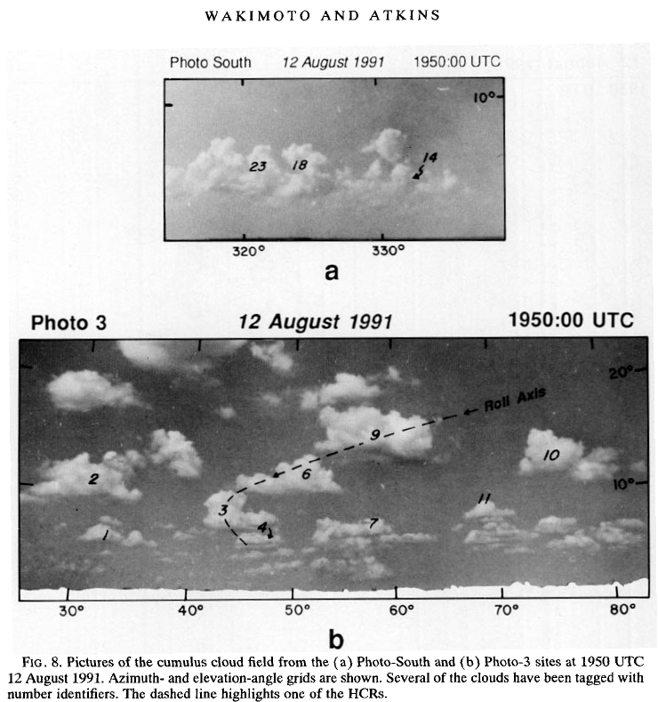
So, given an environment supportive of deep convection (often created by larger-scale forcing), boundaries are preferred locations of CI
But….
  Not all boundaries initiate convection
  Where along the boundary will convection initiate?
  Sometimes, boundaries will need to interact:
From Wakimoto and Atkins (94, mwr)

Slide 10
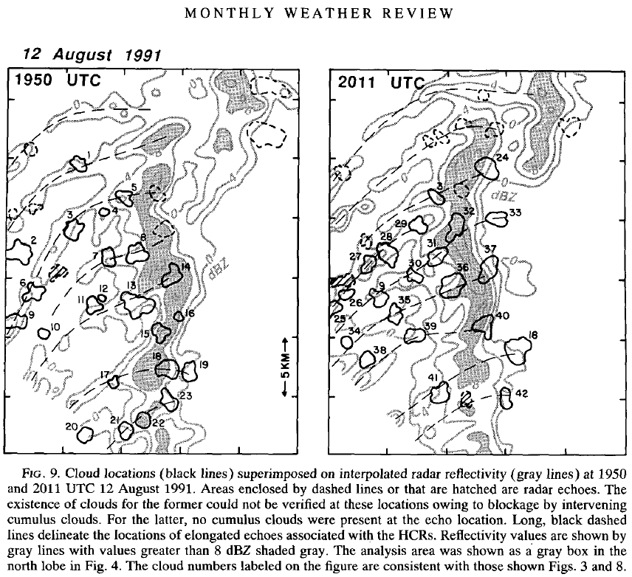
Where are the clouds along the sea breeze front forming?
We still have much to learn about CI
From Wakimoto and Atkins (94, mwr)

Slide 11
So, boundary layer convergence zones are important for CI
But what controls the strength and depth of vertical motion along a boundary?
What controls the variability of forcing along the boundary?

Slide 12
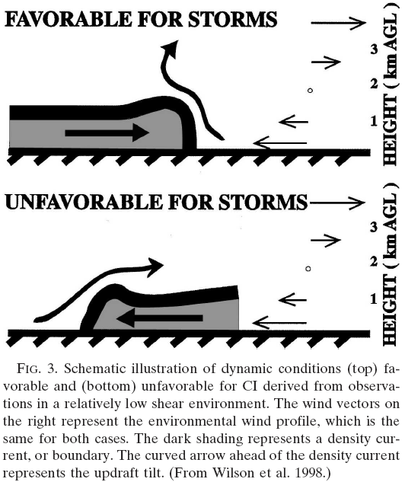
Cold pools and environmental shear may be important….

Slide 13
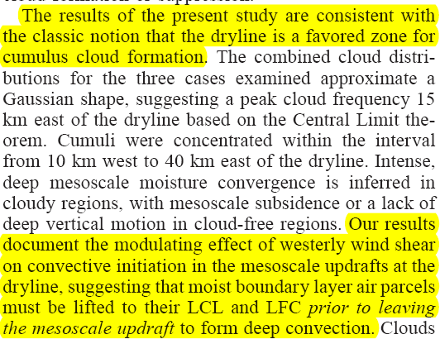
        Ziegler and Rasmussen 98 - MWR

Slide 14
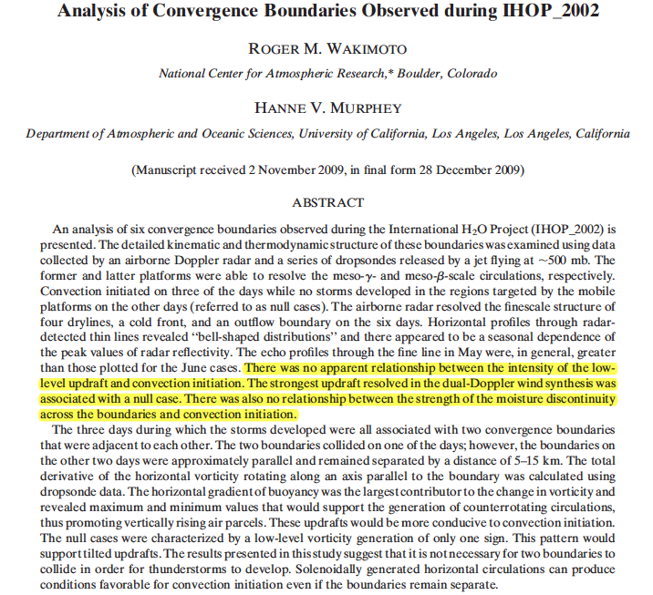
Wakimoto and Murphey – 2010 - MWR
What would a schematic diagram of this last paragraph look like??

Slide 15
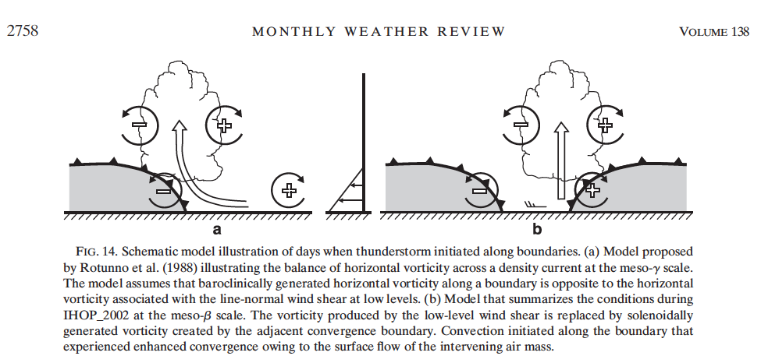
Wakimoto and Murphey – 2010 – MWR
CI cases:
Null case diagram?

Slide 16
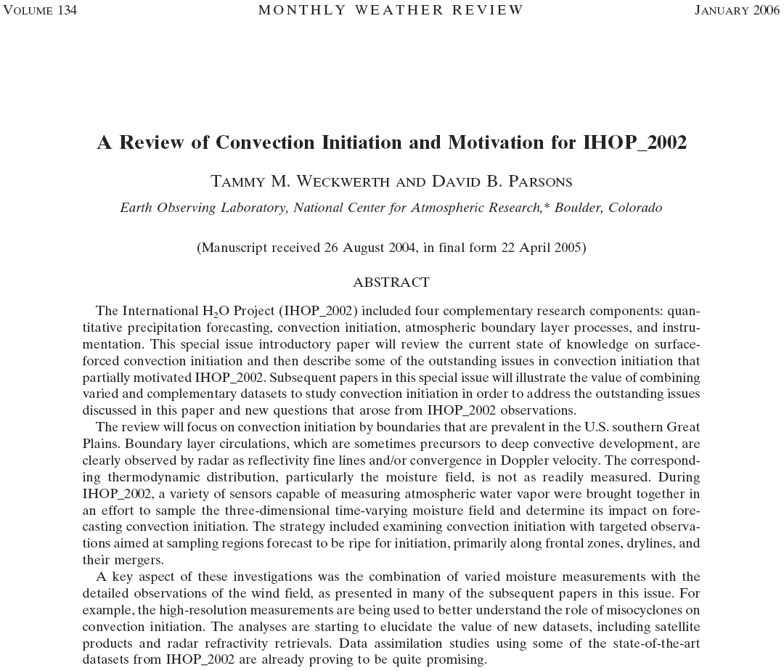

Slide 17
From Wakimoto et al. (2006 – MWR) – IHOP data
Analysis of CI at cf/dl triple point
Notice CI DOES NOT happen at triple point…, why not?

Slide 18
From Wakimoto et al. (2006 – MWR)
Notice the double dryline structure – enhanced W at triple point

Slide 20
Notice all the different thinlines in the radar data
Authors attribute CI to enhanced easterly flow east of dryline enhancing convergence and therefore w
Also note significant along-line variability… why to clouds form at specific locations along boundary?

Slide 21
Notice misocyclones along dryline
Relationship to vertical velocity maxima?

Slide 22
Murphy et al. 06 – MWR
Misocyclones create along-line variability
Enhanced convergence and moisture north of circulation – CI location?
They are also incipient circulations for nonsupercell tornadoes…., more on this later in the tornado section

Slide 23
Marquis et al. 2007 - MWR

Slide 24
Marquis et al. 2007 – MWR
Note how the misocyclones discontinuously distort the boundary
Produced as stair-step pattern
Misocyclones were observed to merge together – producing larger misocyclones.

Slide 25
MWR - 2006

Slide 26
Xue et al. 2006 - MWR

Slide 27
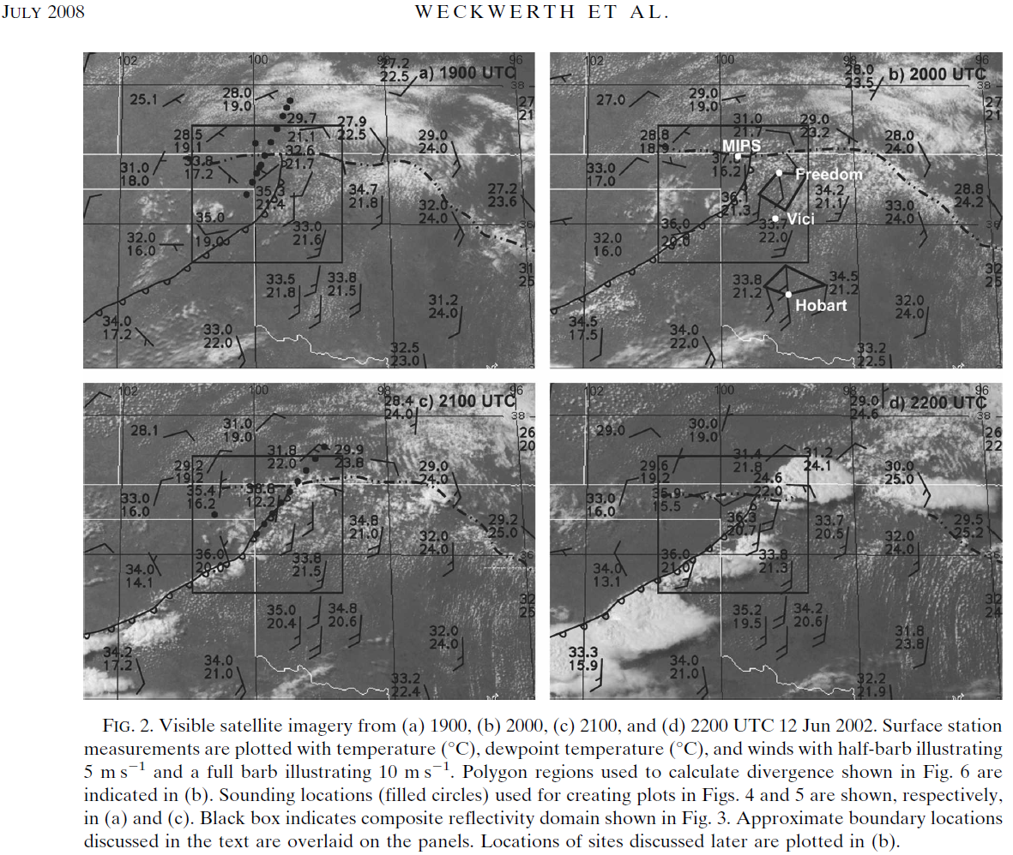
MWR
Outflow boundary
dryline
Gravity
waves
HCRs
How are these boundaries involved with CI?

Slide 28

BAMS –
December 2007

Slide 29
Project hypothesis:
CI will occur where lid is weaker or where boundary layer convection/forced lifting can eliminate it.
Browning et al. 2007 - BAMS

Slide 30
Radar data of a lid and developing convection
Q: How is the radar observing the lid? What is the scattering source?
Browning et al. 2007 - BAMS

Slide 31
There are many, many more studies on the subject of CI…, bottom line, we still have much to learn.

